Slide 2
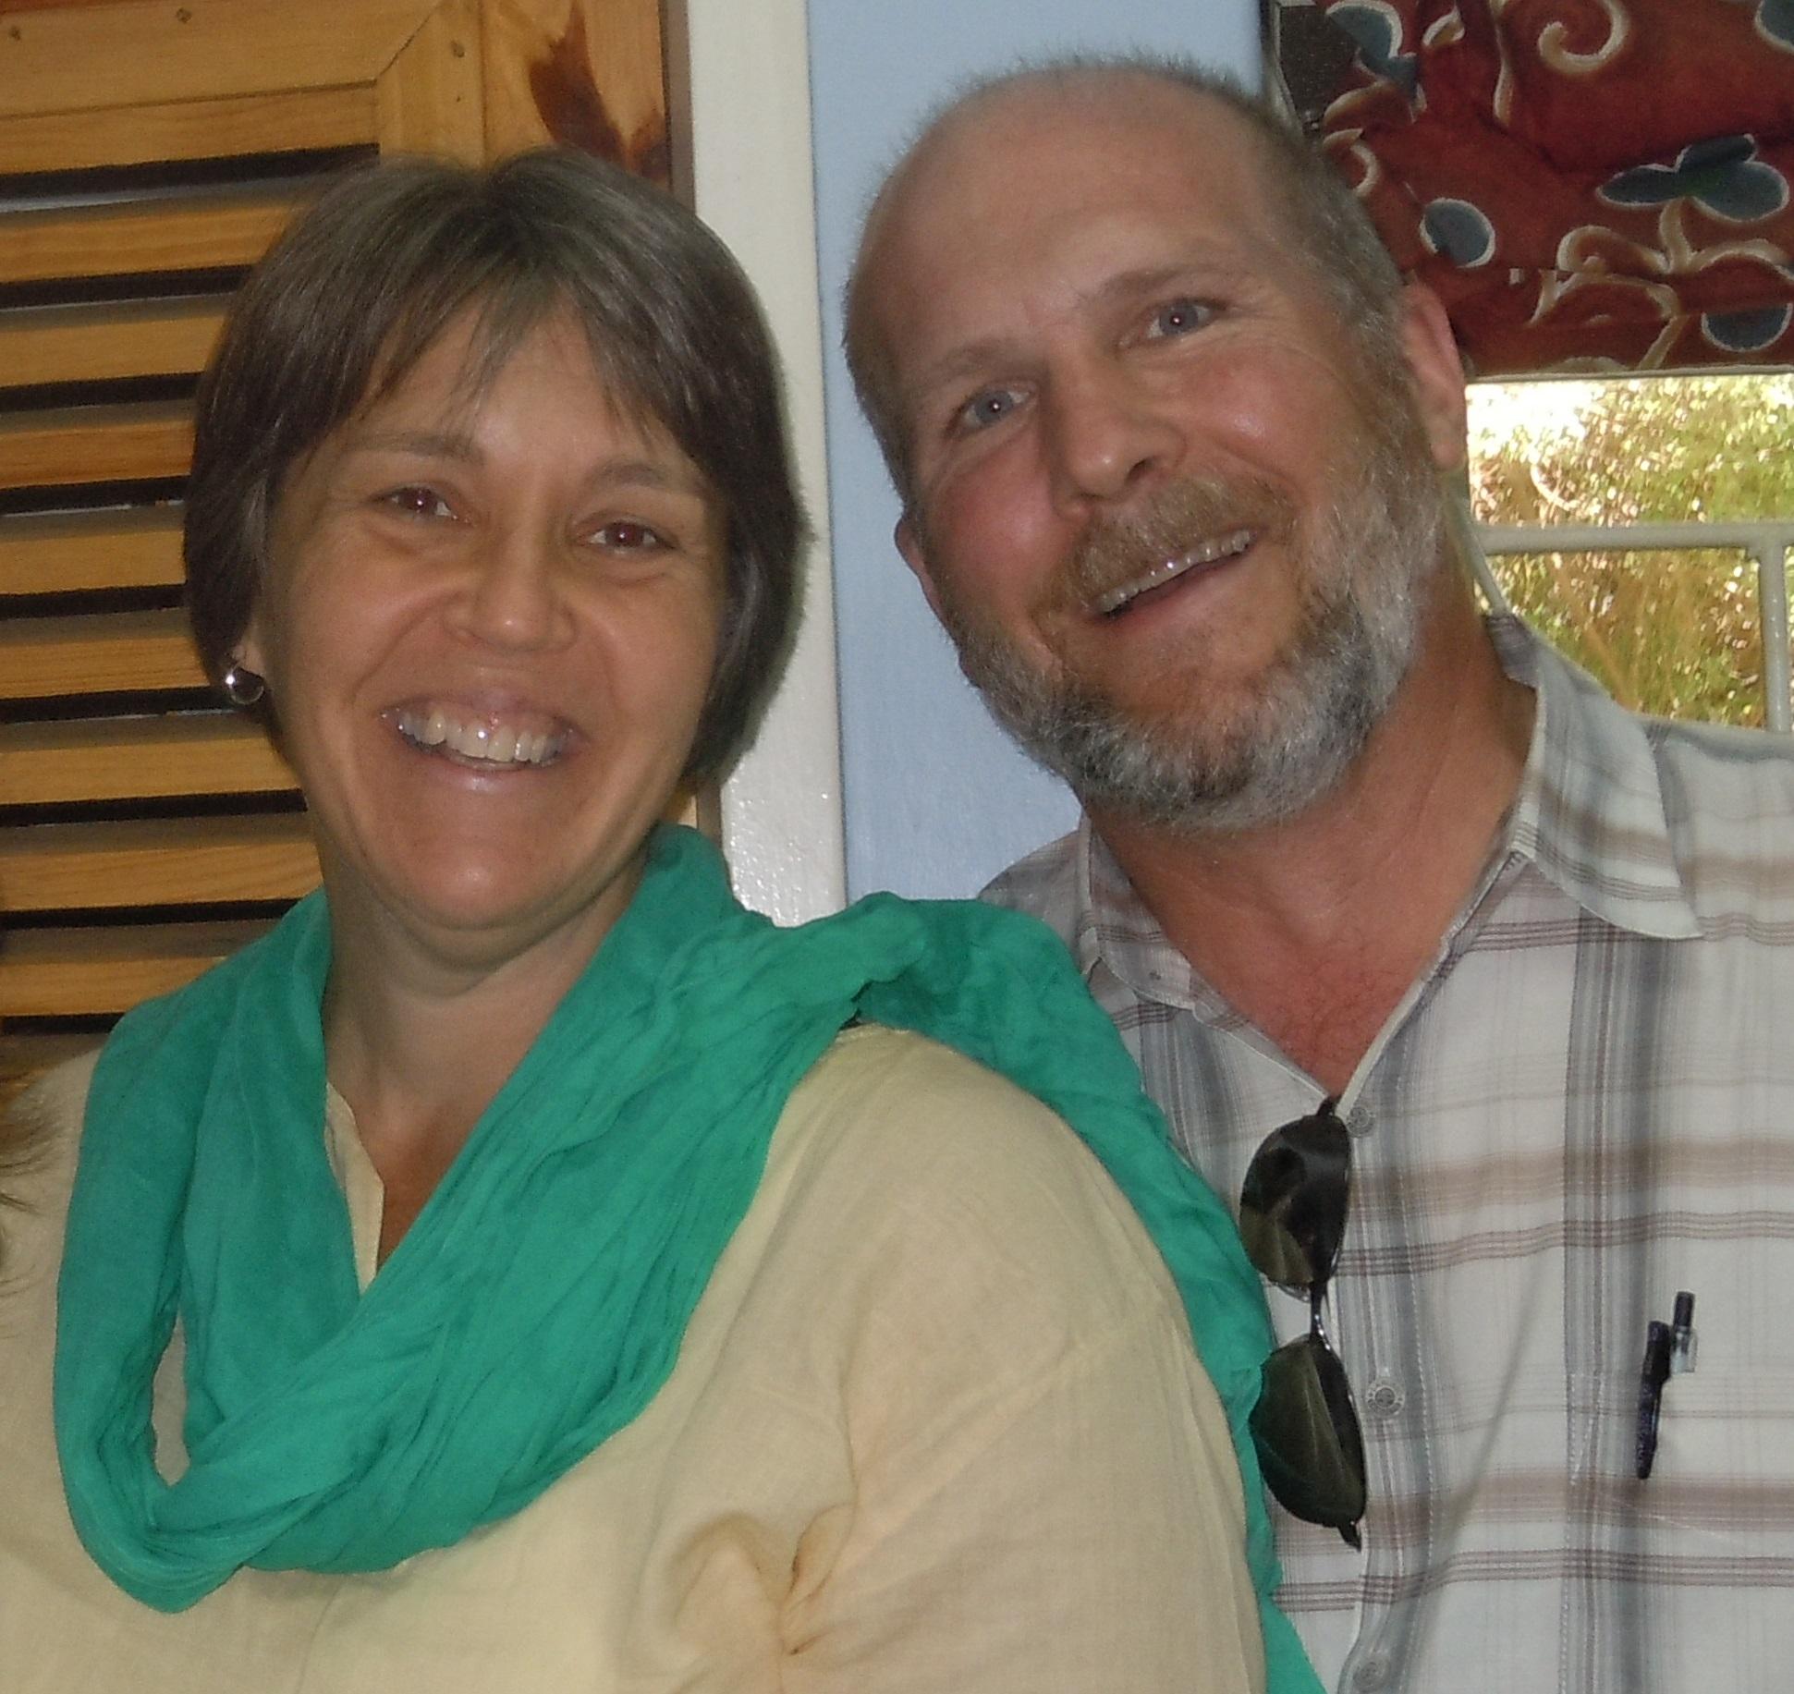

Slide 3
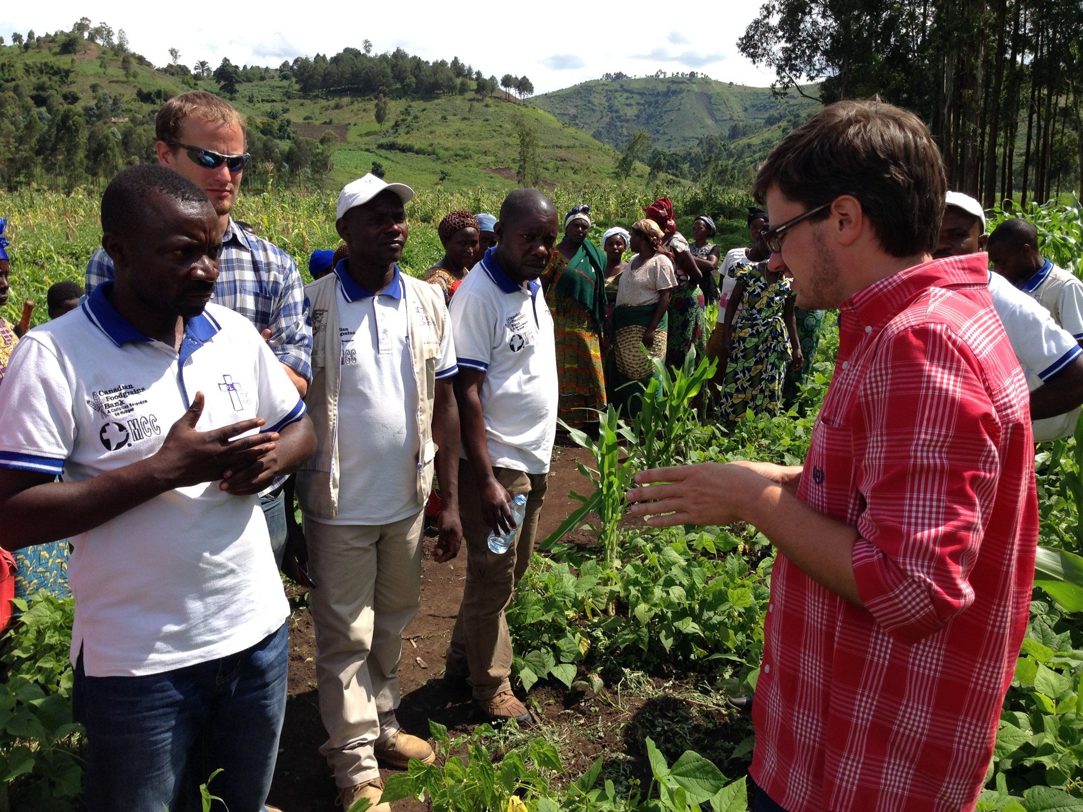

Slide 4
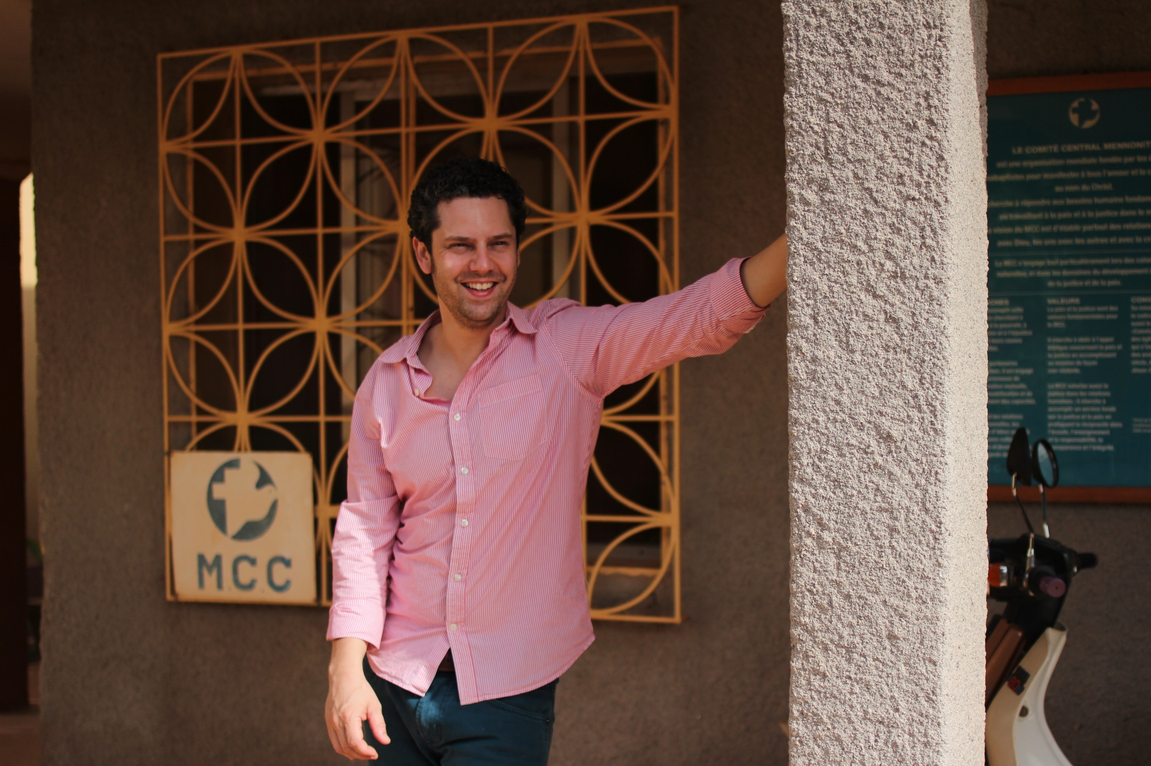

Slide 6
Luke 10:25-28
25 Just then a lawyer stood up to test Jesus. ‘Teacher,’ he said, ‘what must I do to inherit eternal life?’ 26He said to him, ‘What is written in the law? What do you read there?’ 27He answered, ‘You shall love the Lord your God with all your heart, and with all your soul, and with all your strength, and with all your mind; and your neighbor as yourself.’ 28And he said to him, ‘You have given the right answer; do this, and you will live.’

Slide 7
The Parable of the Good Samaritan (Luke 10:29-37)
29 But wanting to justify himself, he asked Jesus, ‘And who is my neighbor?’ . . .
³⁶Which of these three, do you think, was a neighbor to the man who fell into the hands of the robbers?’ ³⁷He said, ‘The one who showed him mercy.’ Jesus said to him, ‘Go and do likewise.’

Slide 8
Mennonite Central Committee Relief, development and peace in the name of Christ

Slide 9
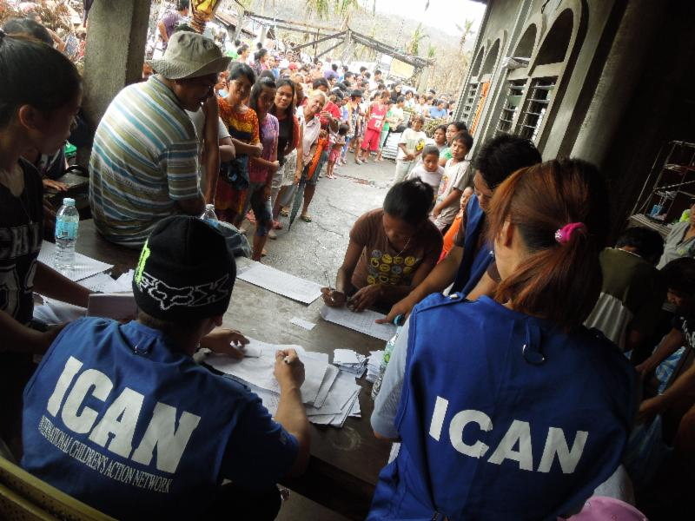

Slide 10
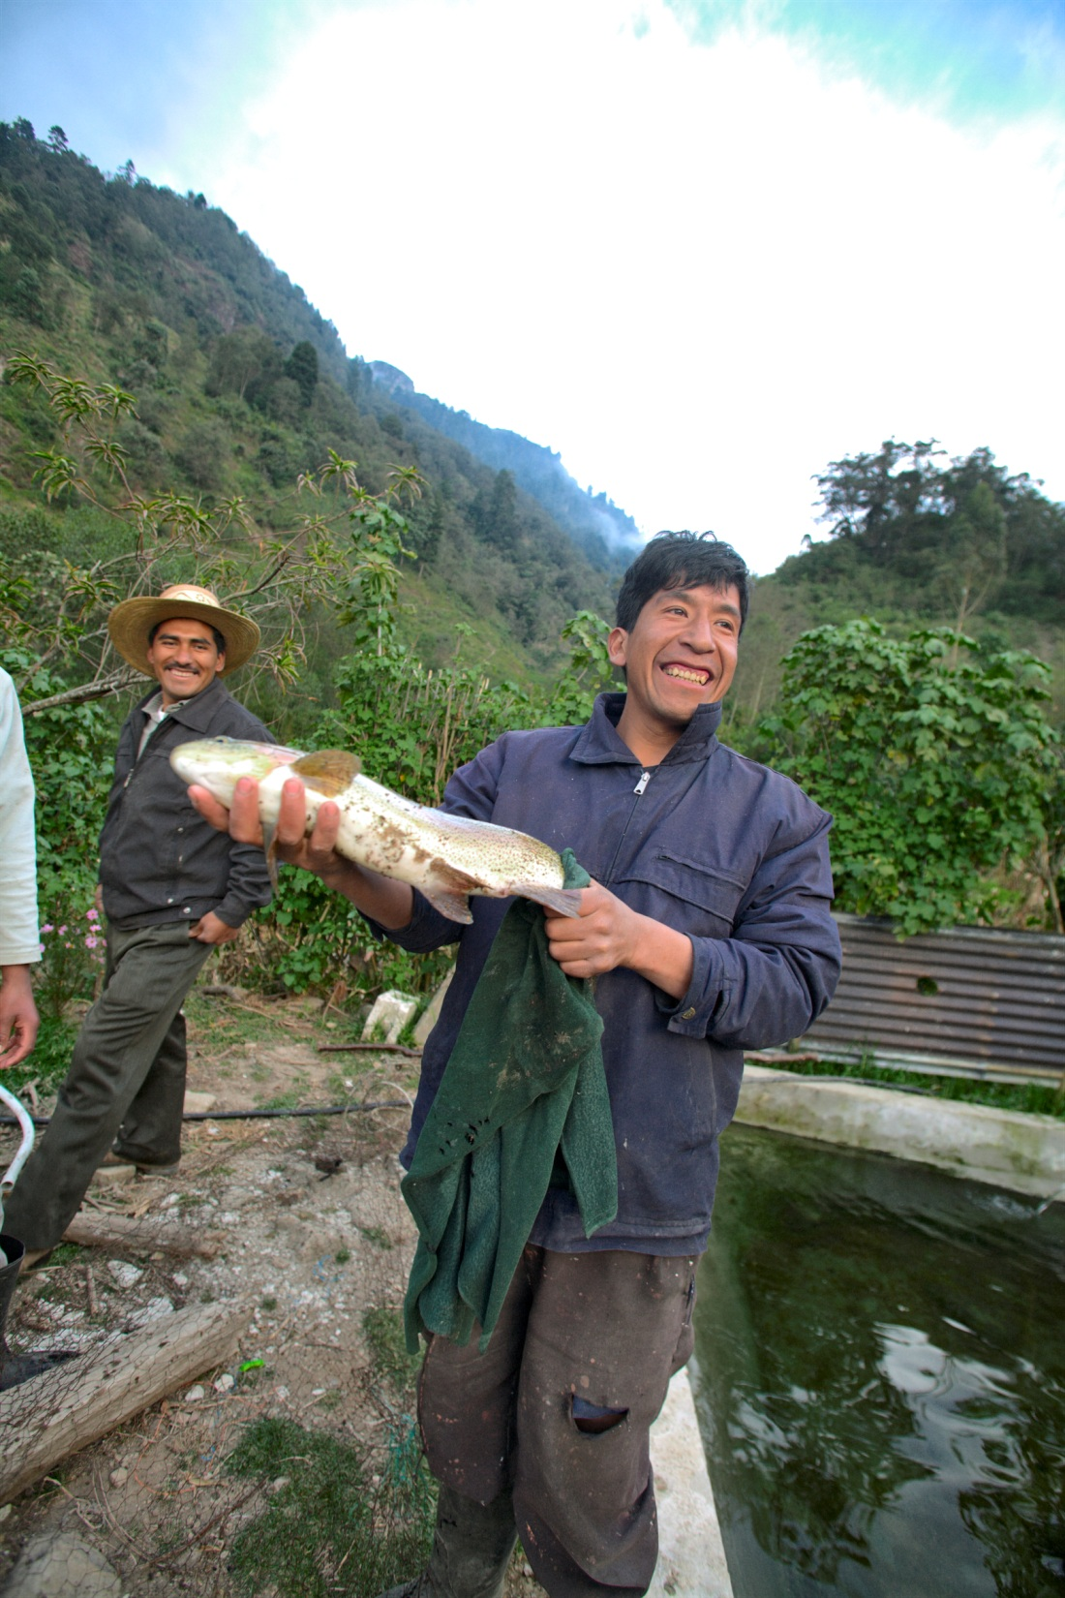

Slide 11
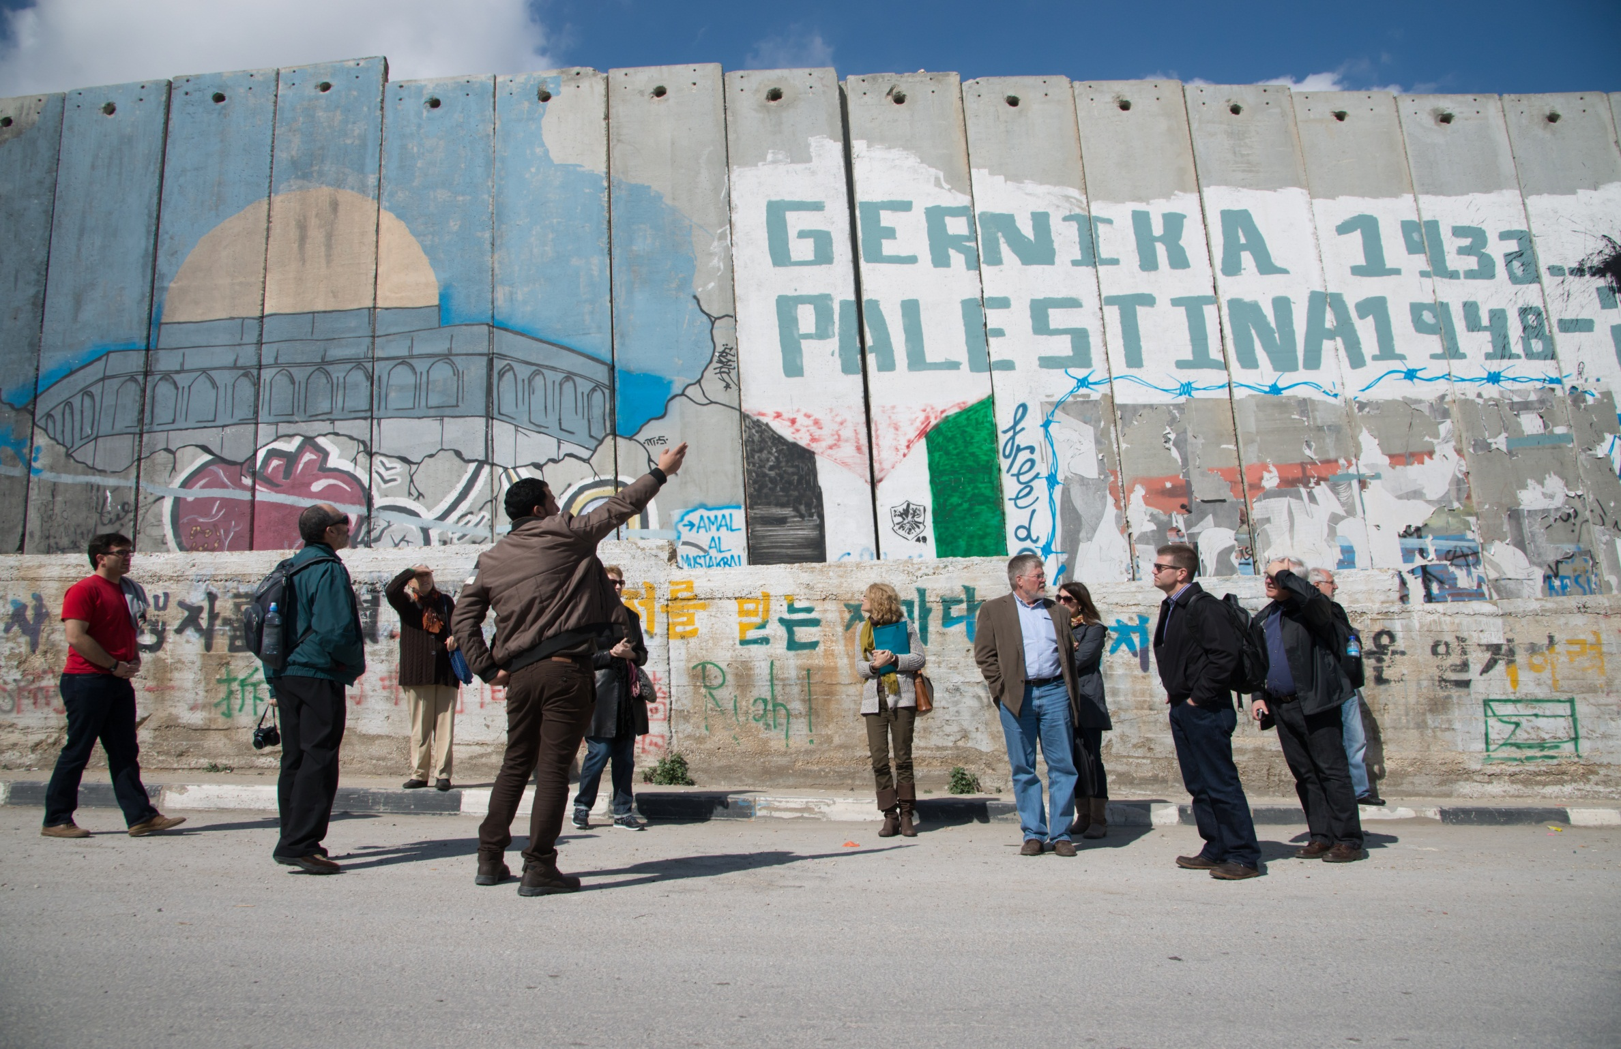

Slide 12
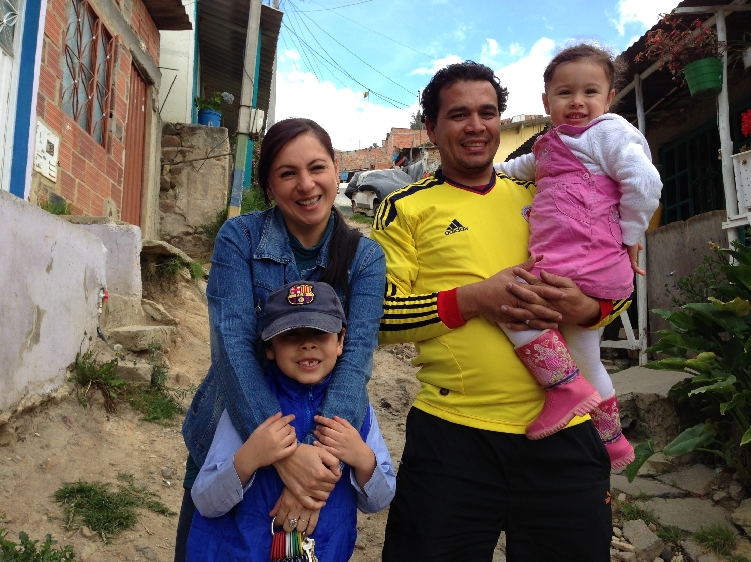

Slide 14
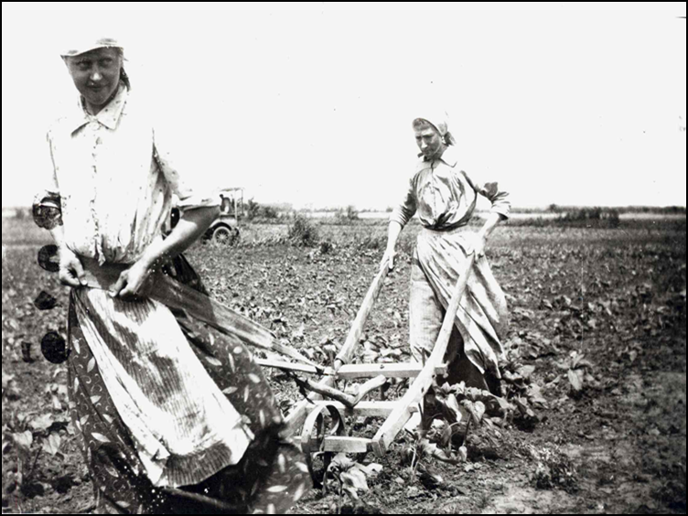

Slide 15
The Parable of the Good Samaritan (Luke 10:29-37)
29 But wanting to justify himself, he asked Jesus, ‘And who is my neighbor?’ . . .
³⁶Which of these three, do you think, was a neighbor to the man who fell into the hands of the robbers?’ ³⁷He said, ‘The one who showed him mercy.’ Jesus said to him, ‘Go and do likewise.’

Slide 16
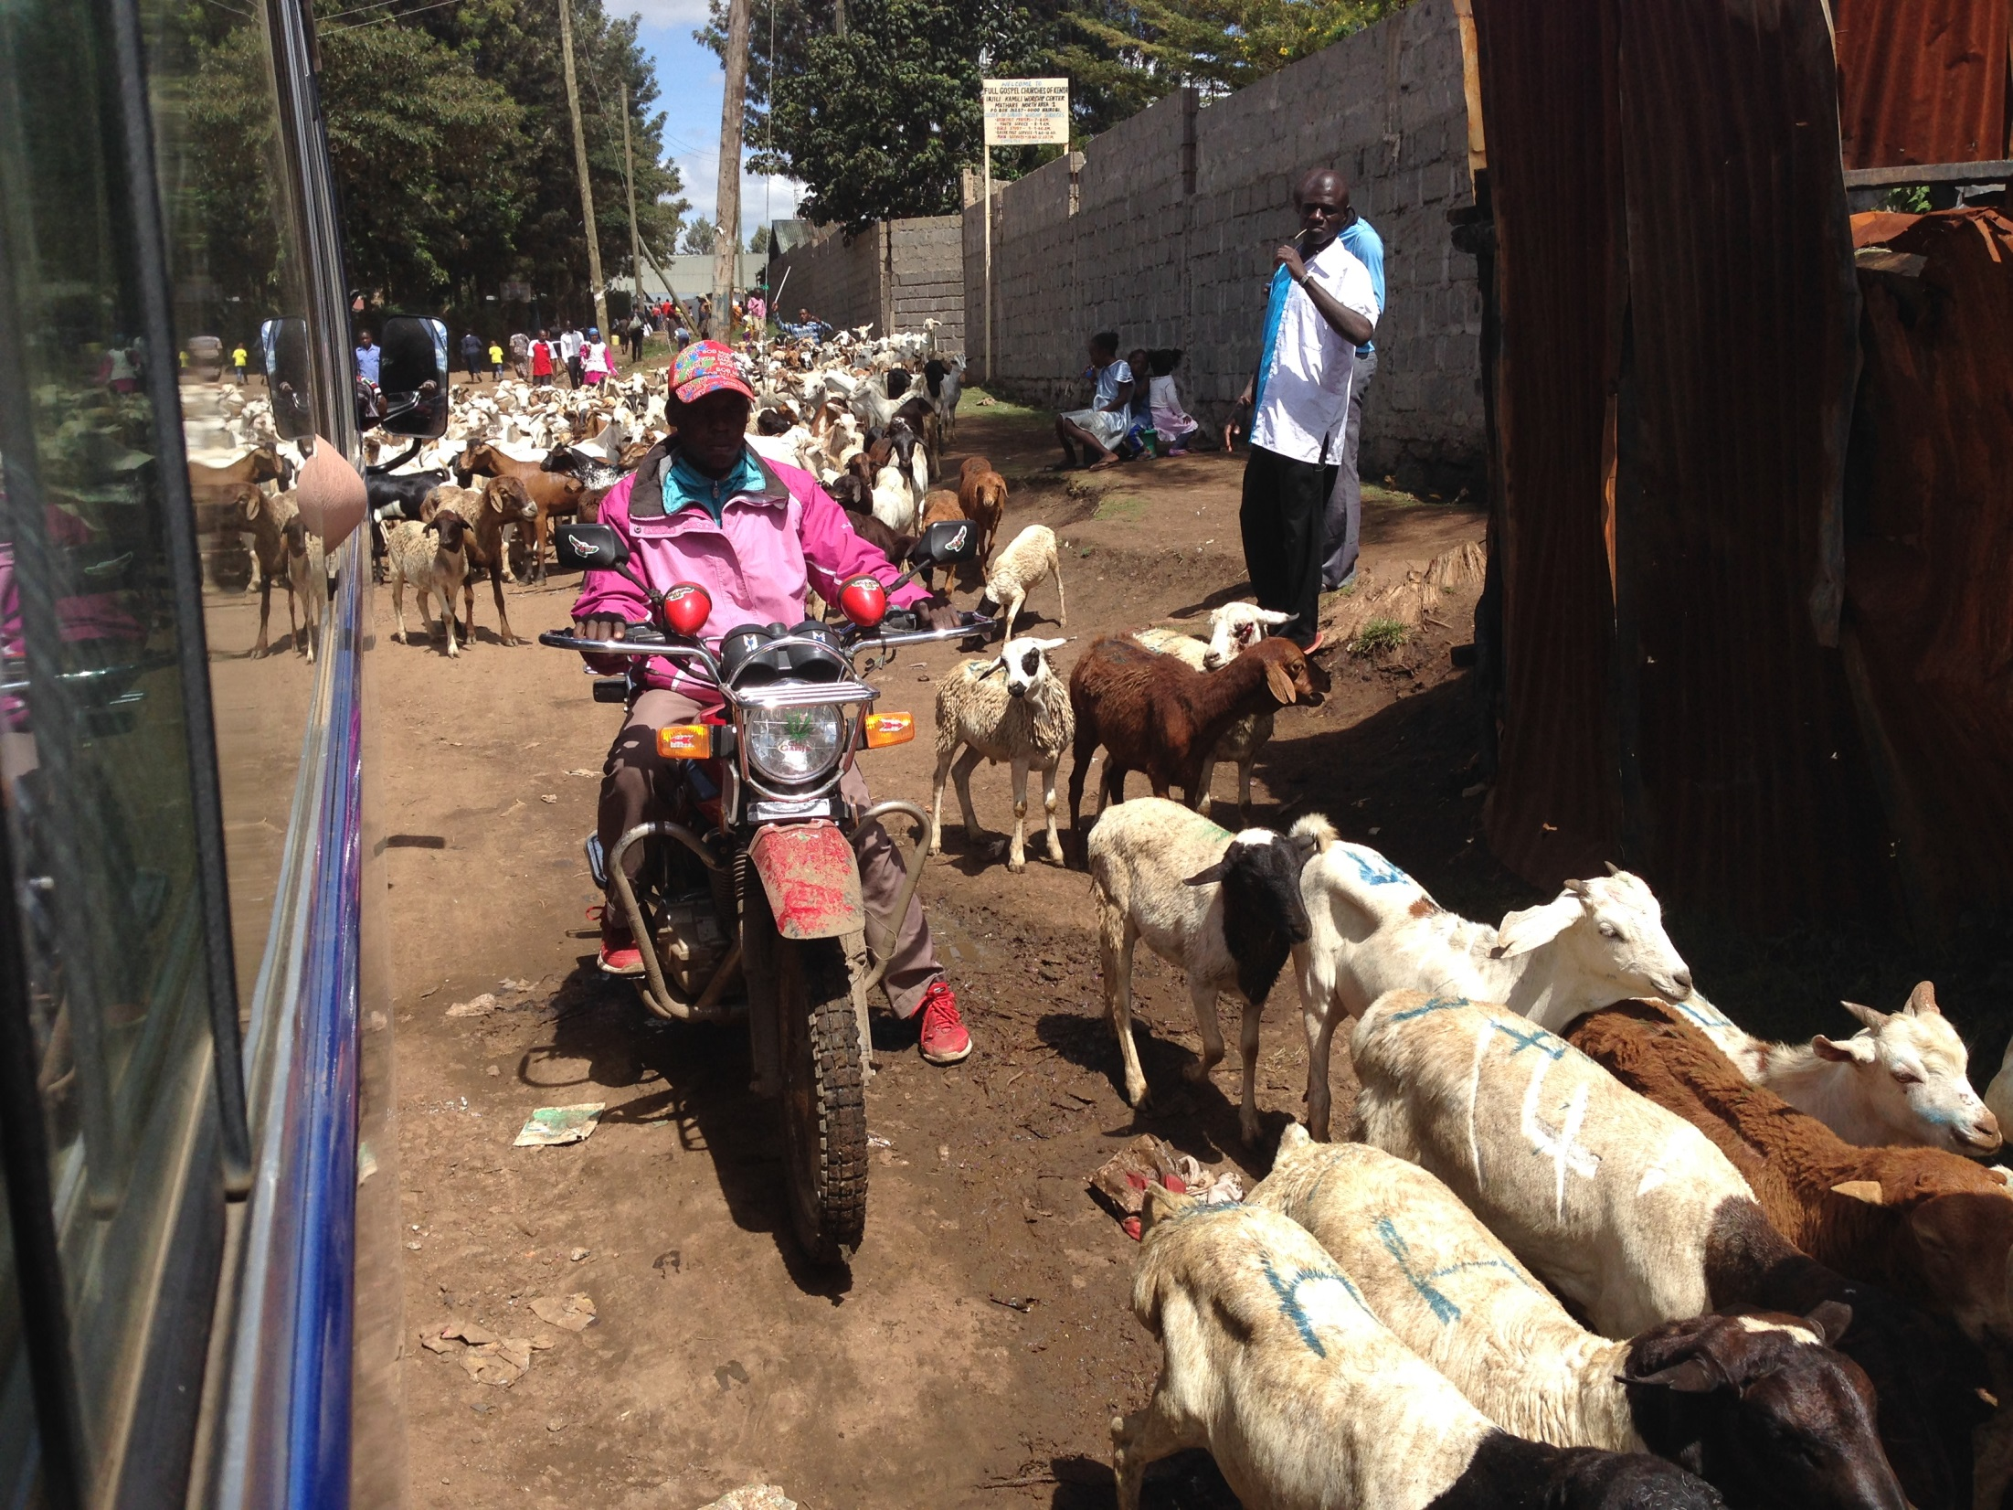

Slide 17
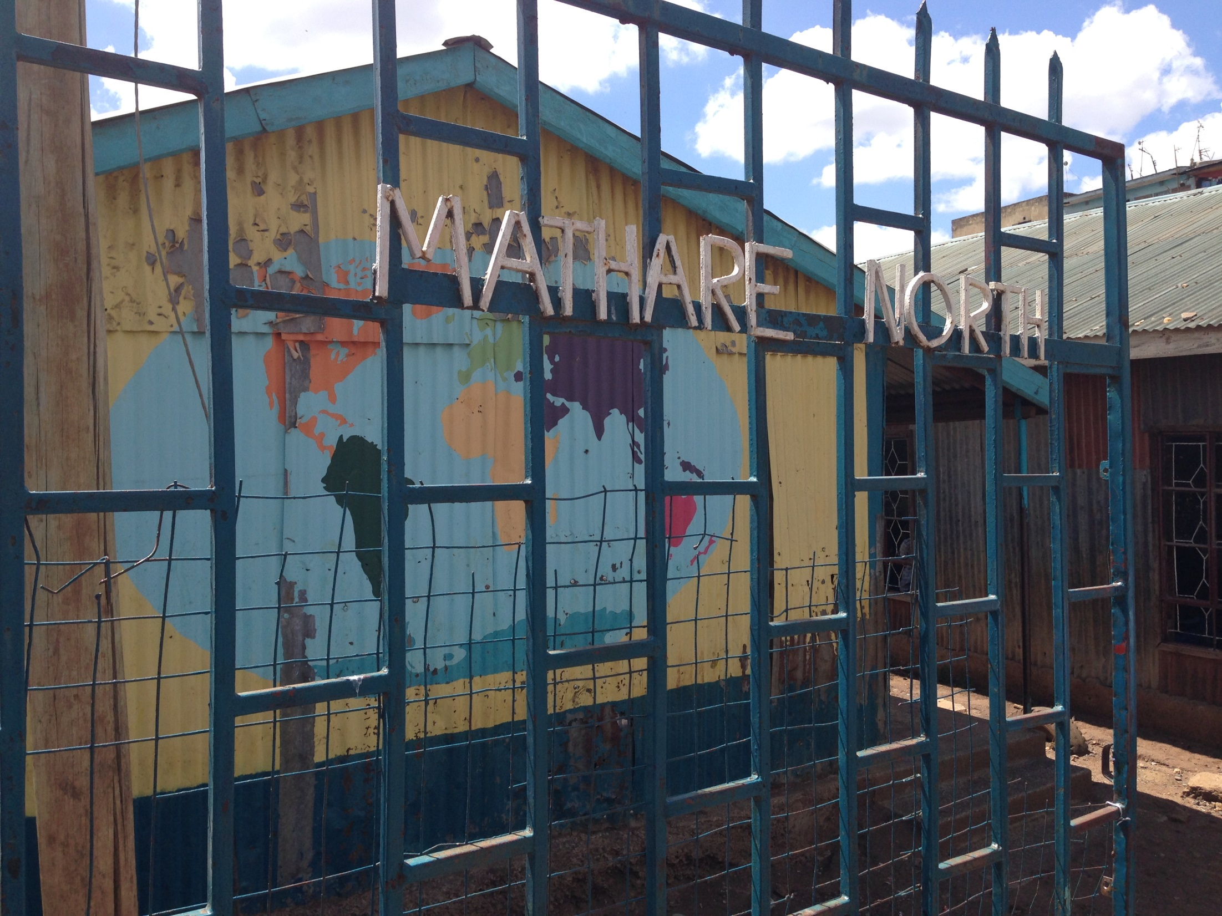

Slide 18
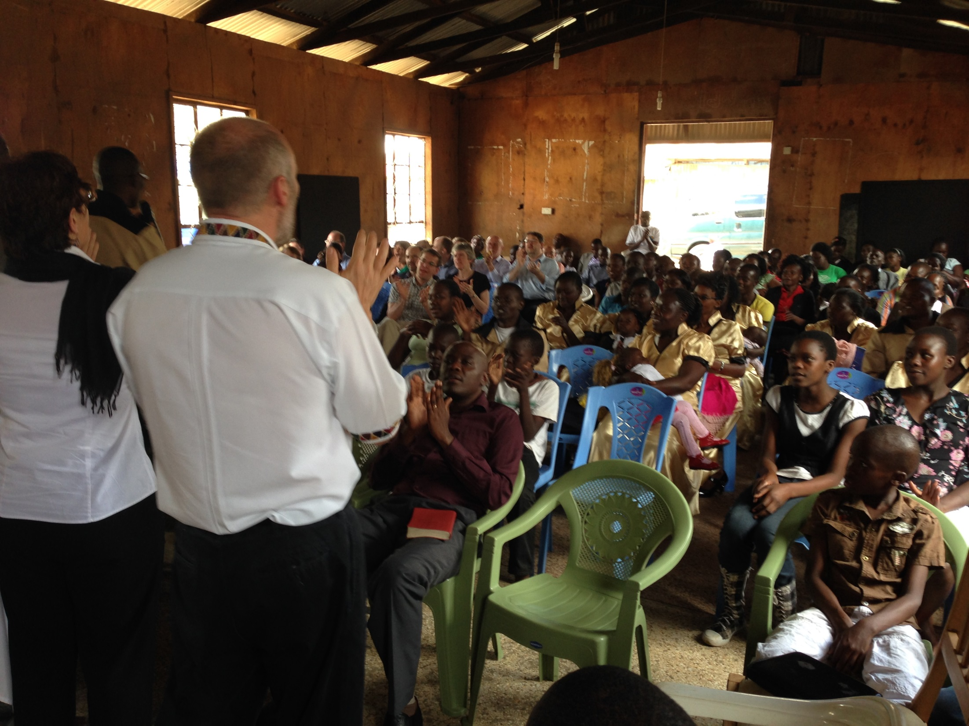

Slide 19
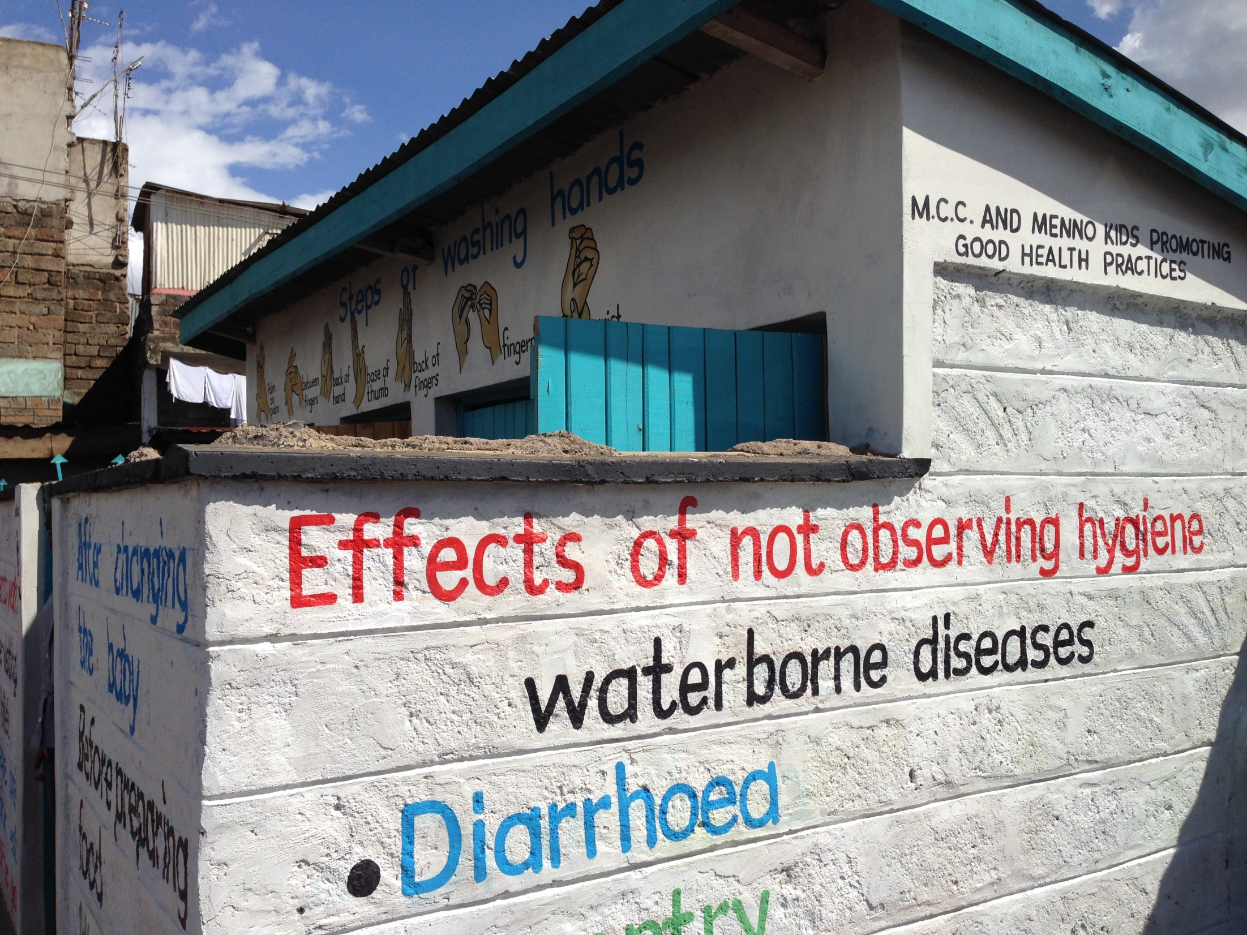

Slide 20
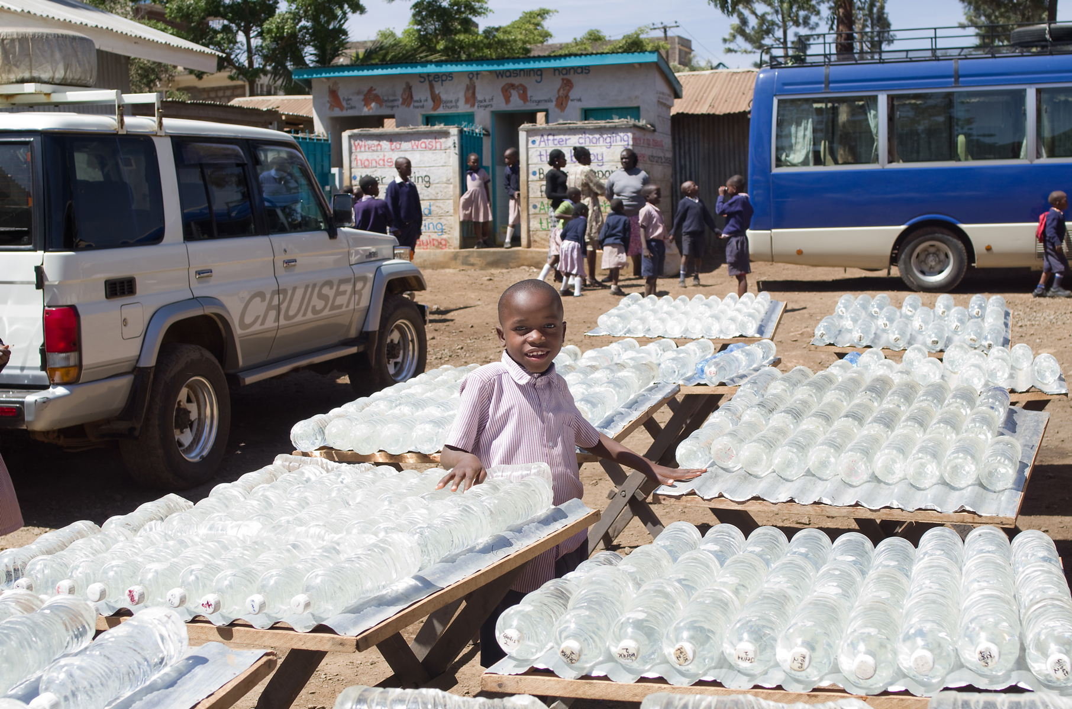

Slide 21
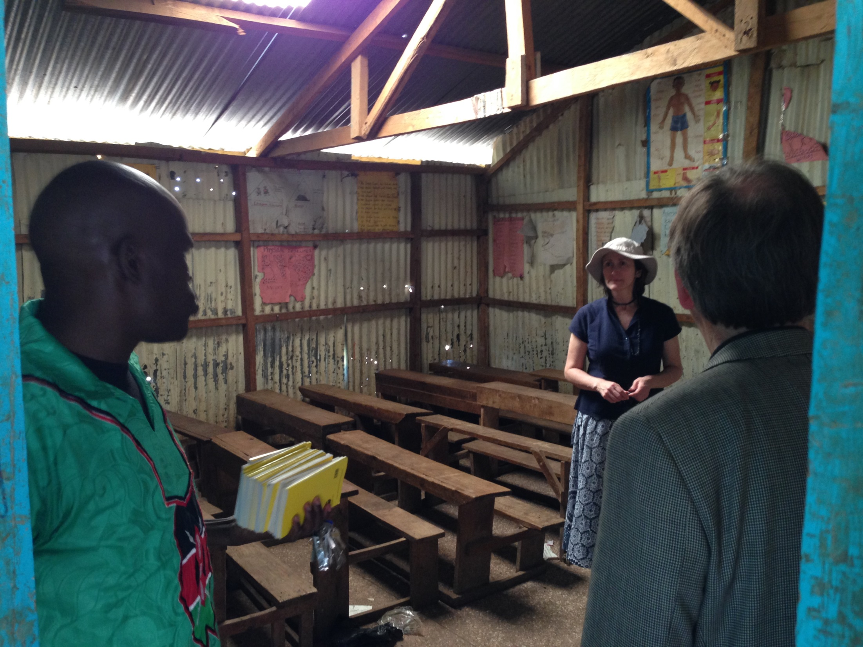

Slide 22
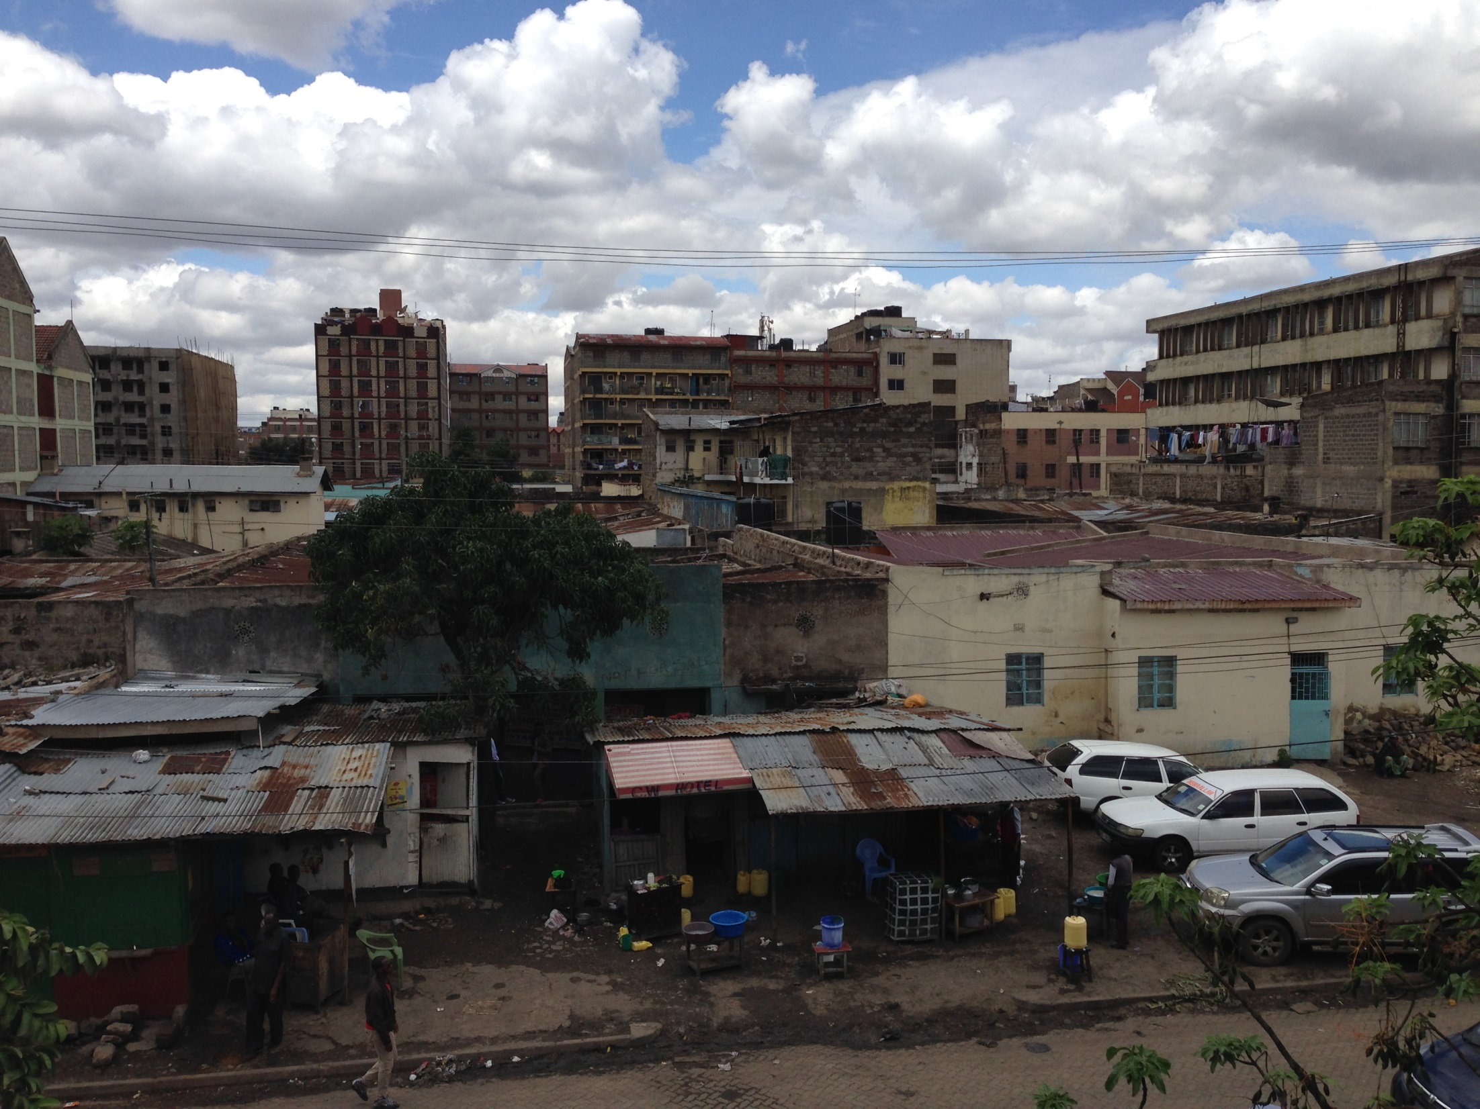

Slide 23
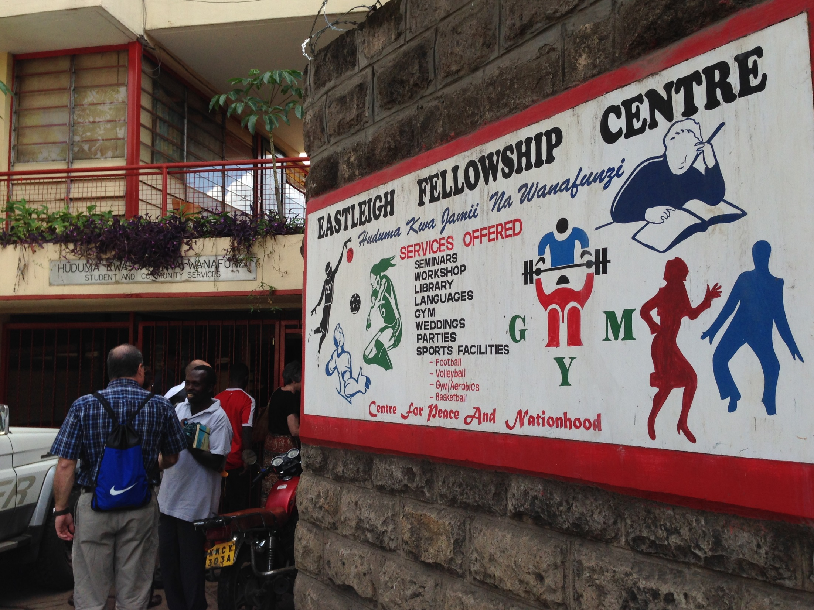

Slide 24
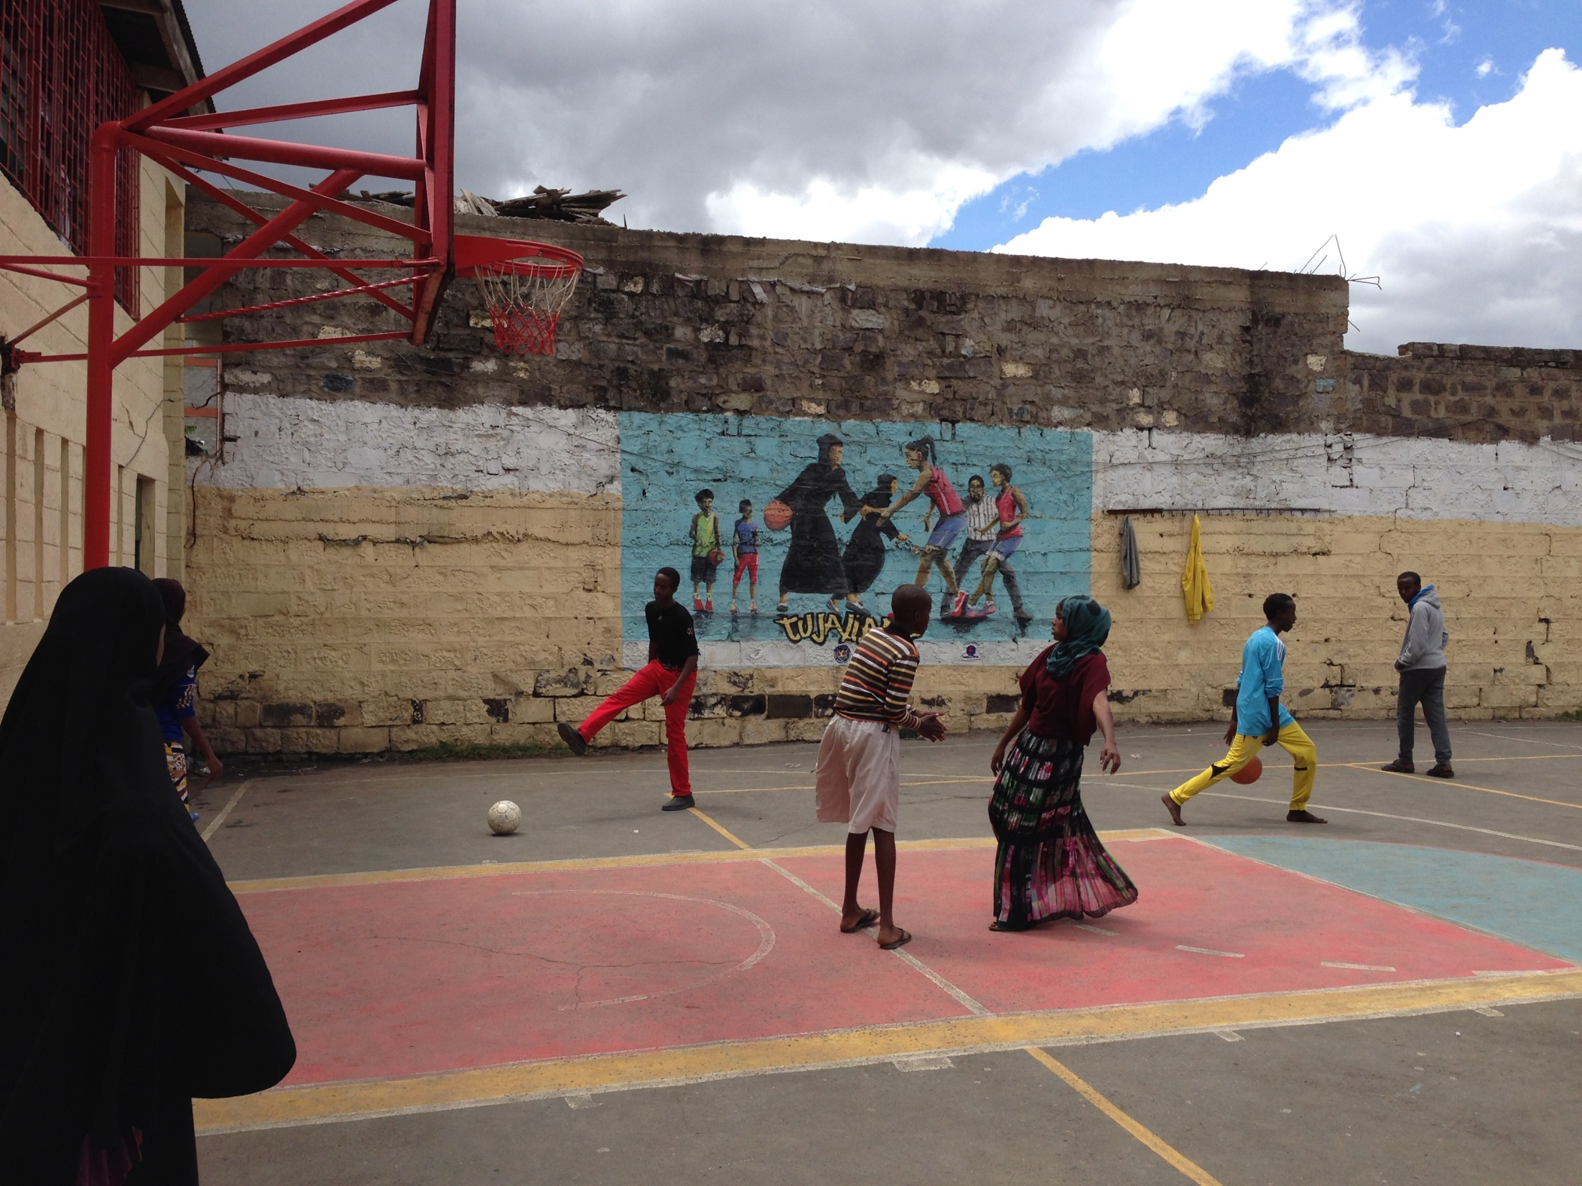

Slide 25
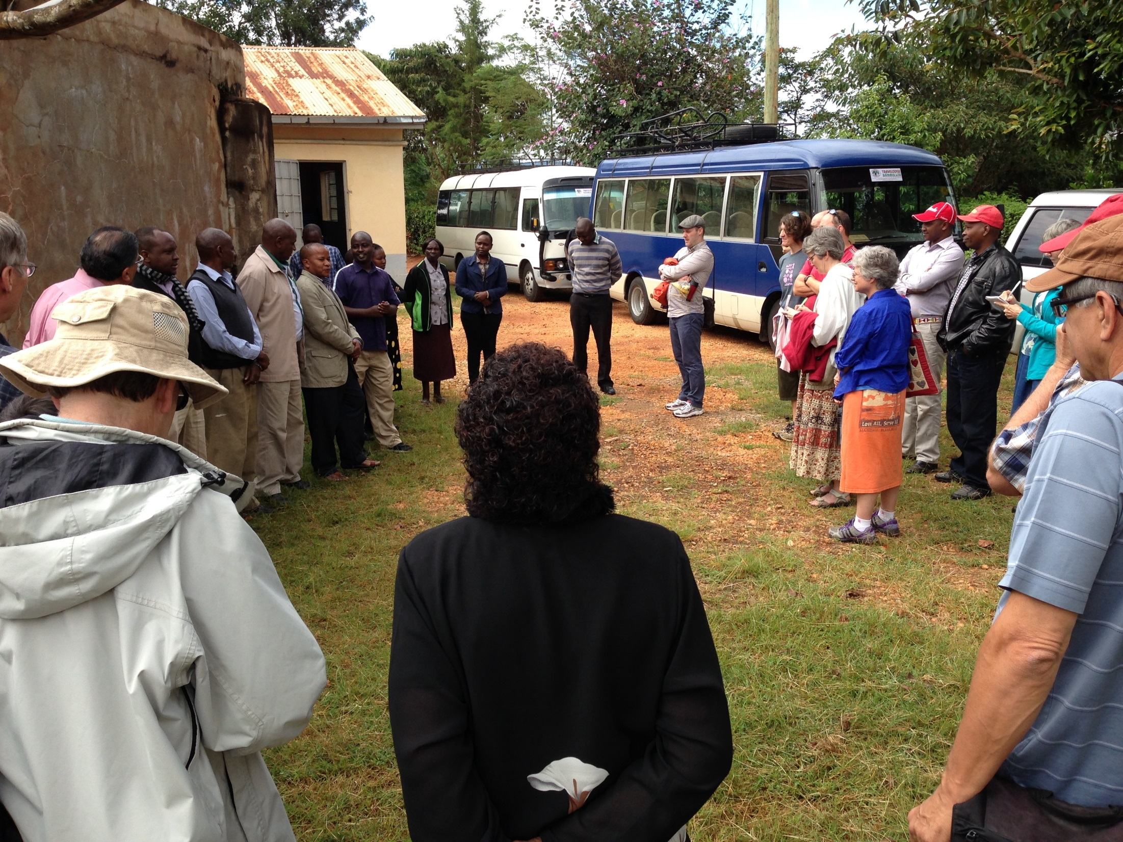

Slide 26
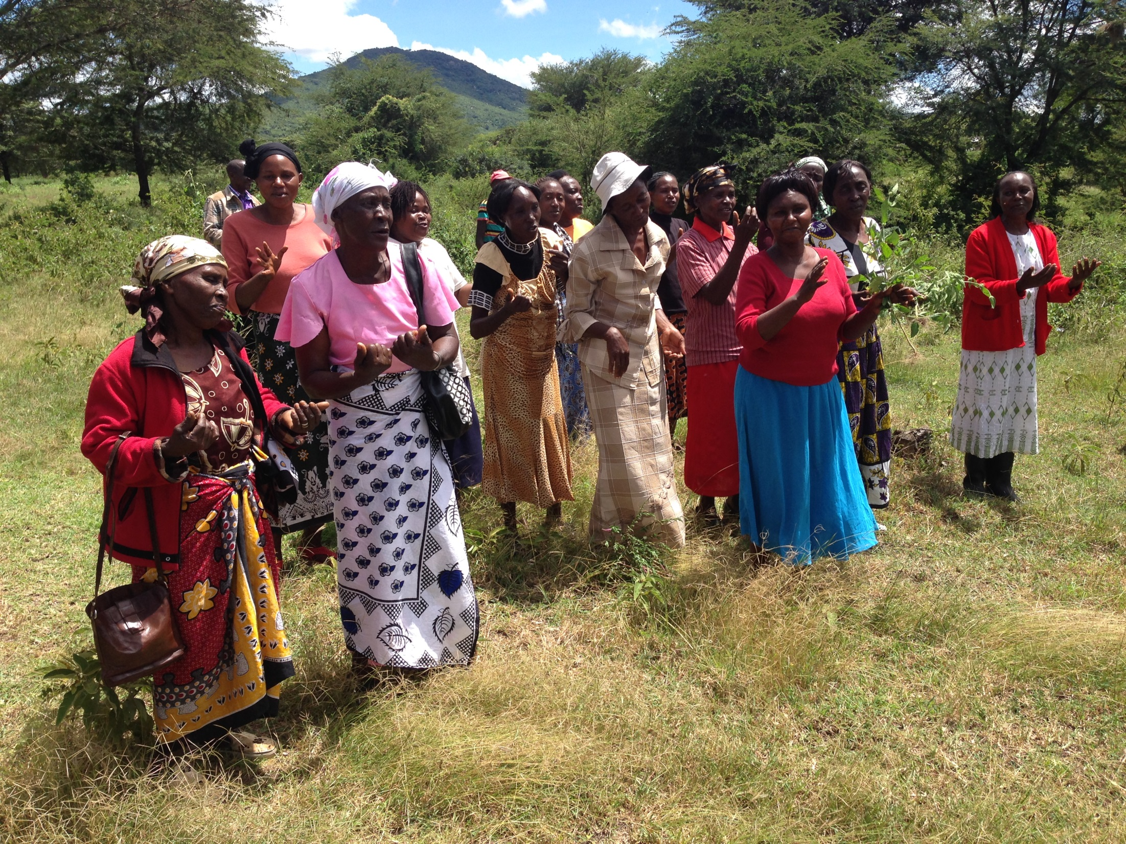

Slide 27
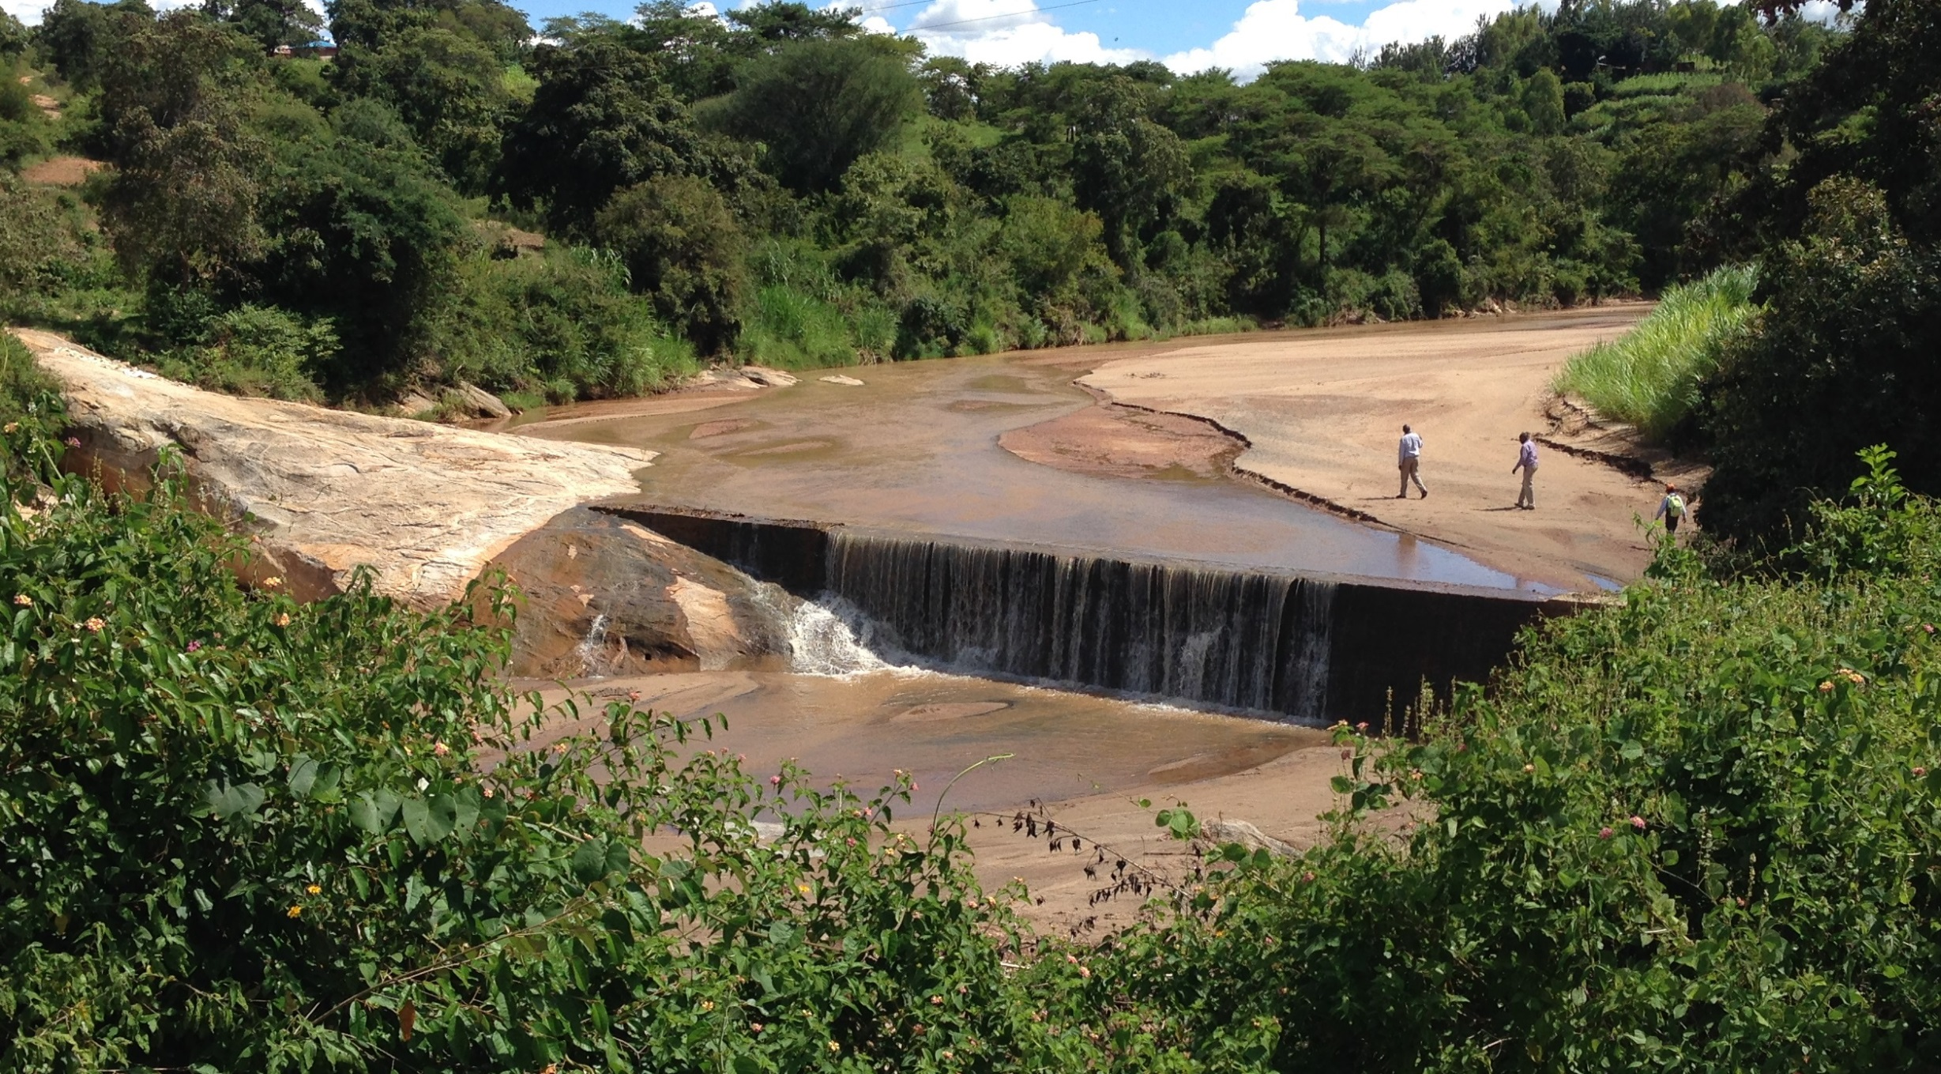

Slide 28
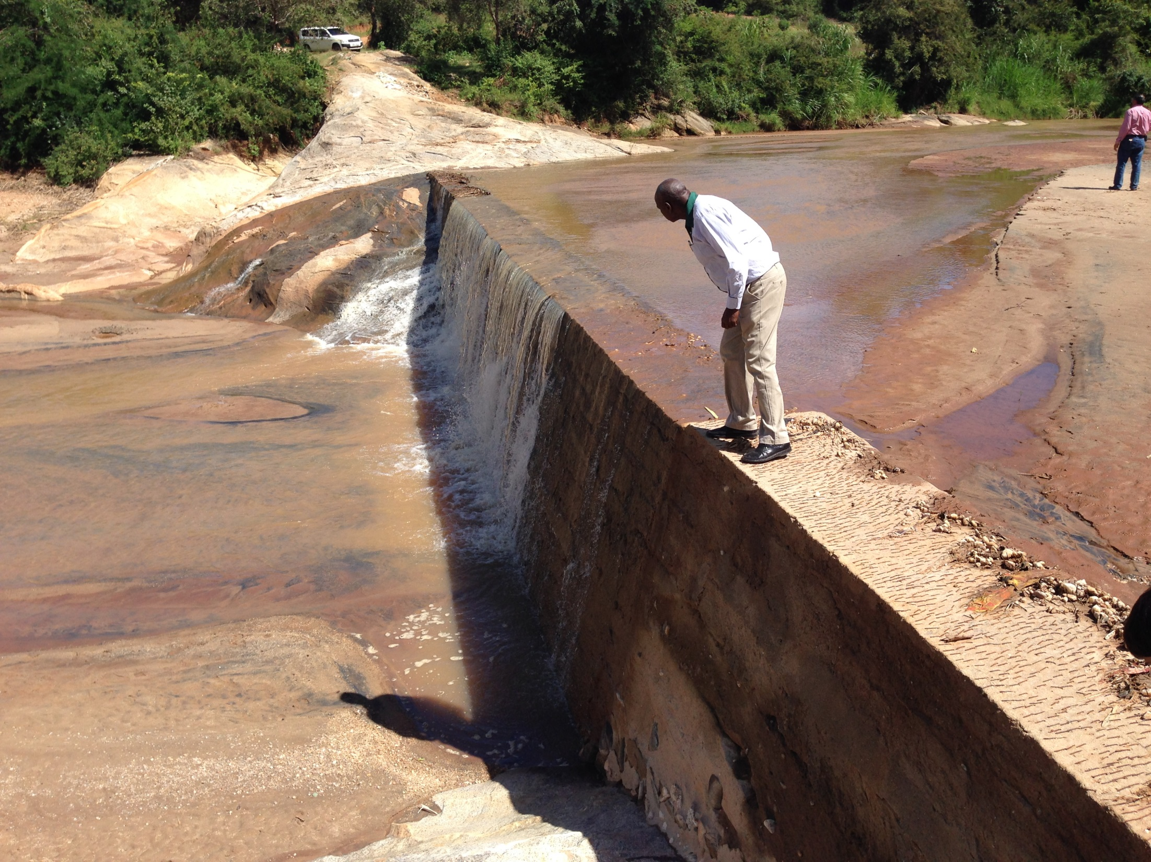

Slide 29
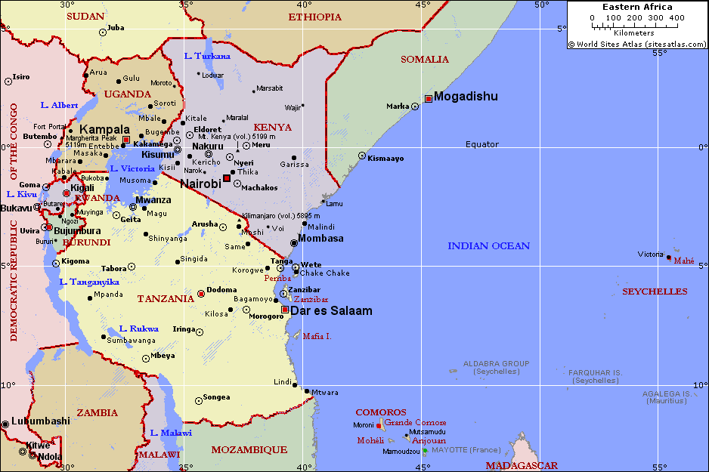

Slide 30
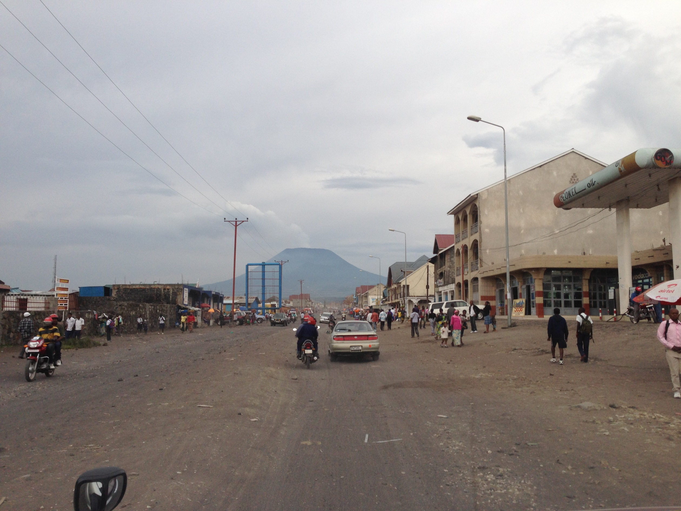

Slide 31
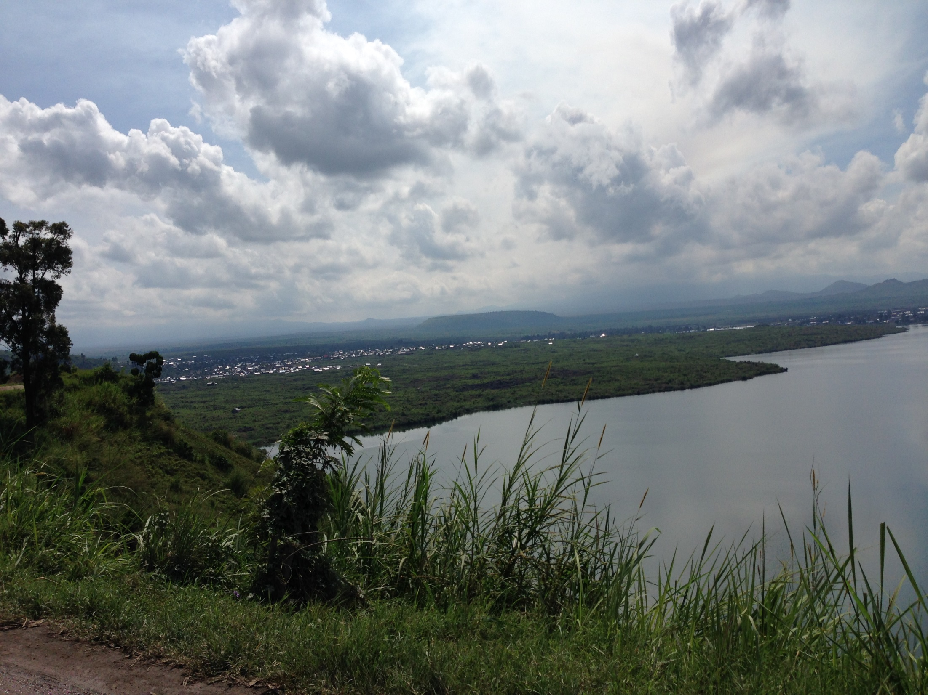

Slide 32
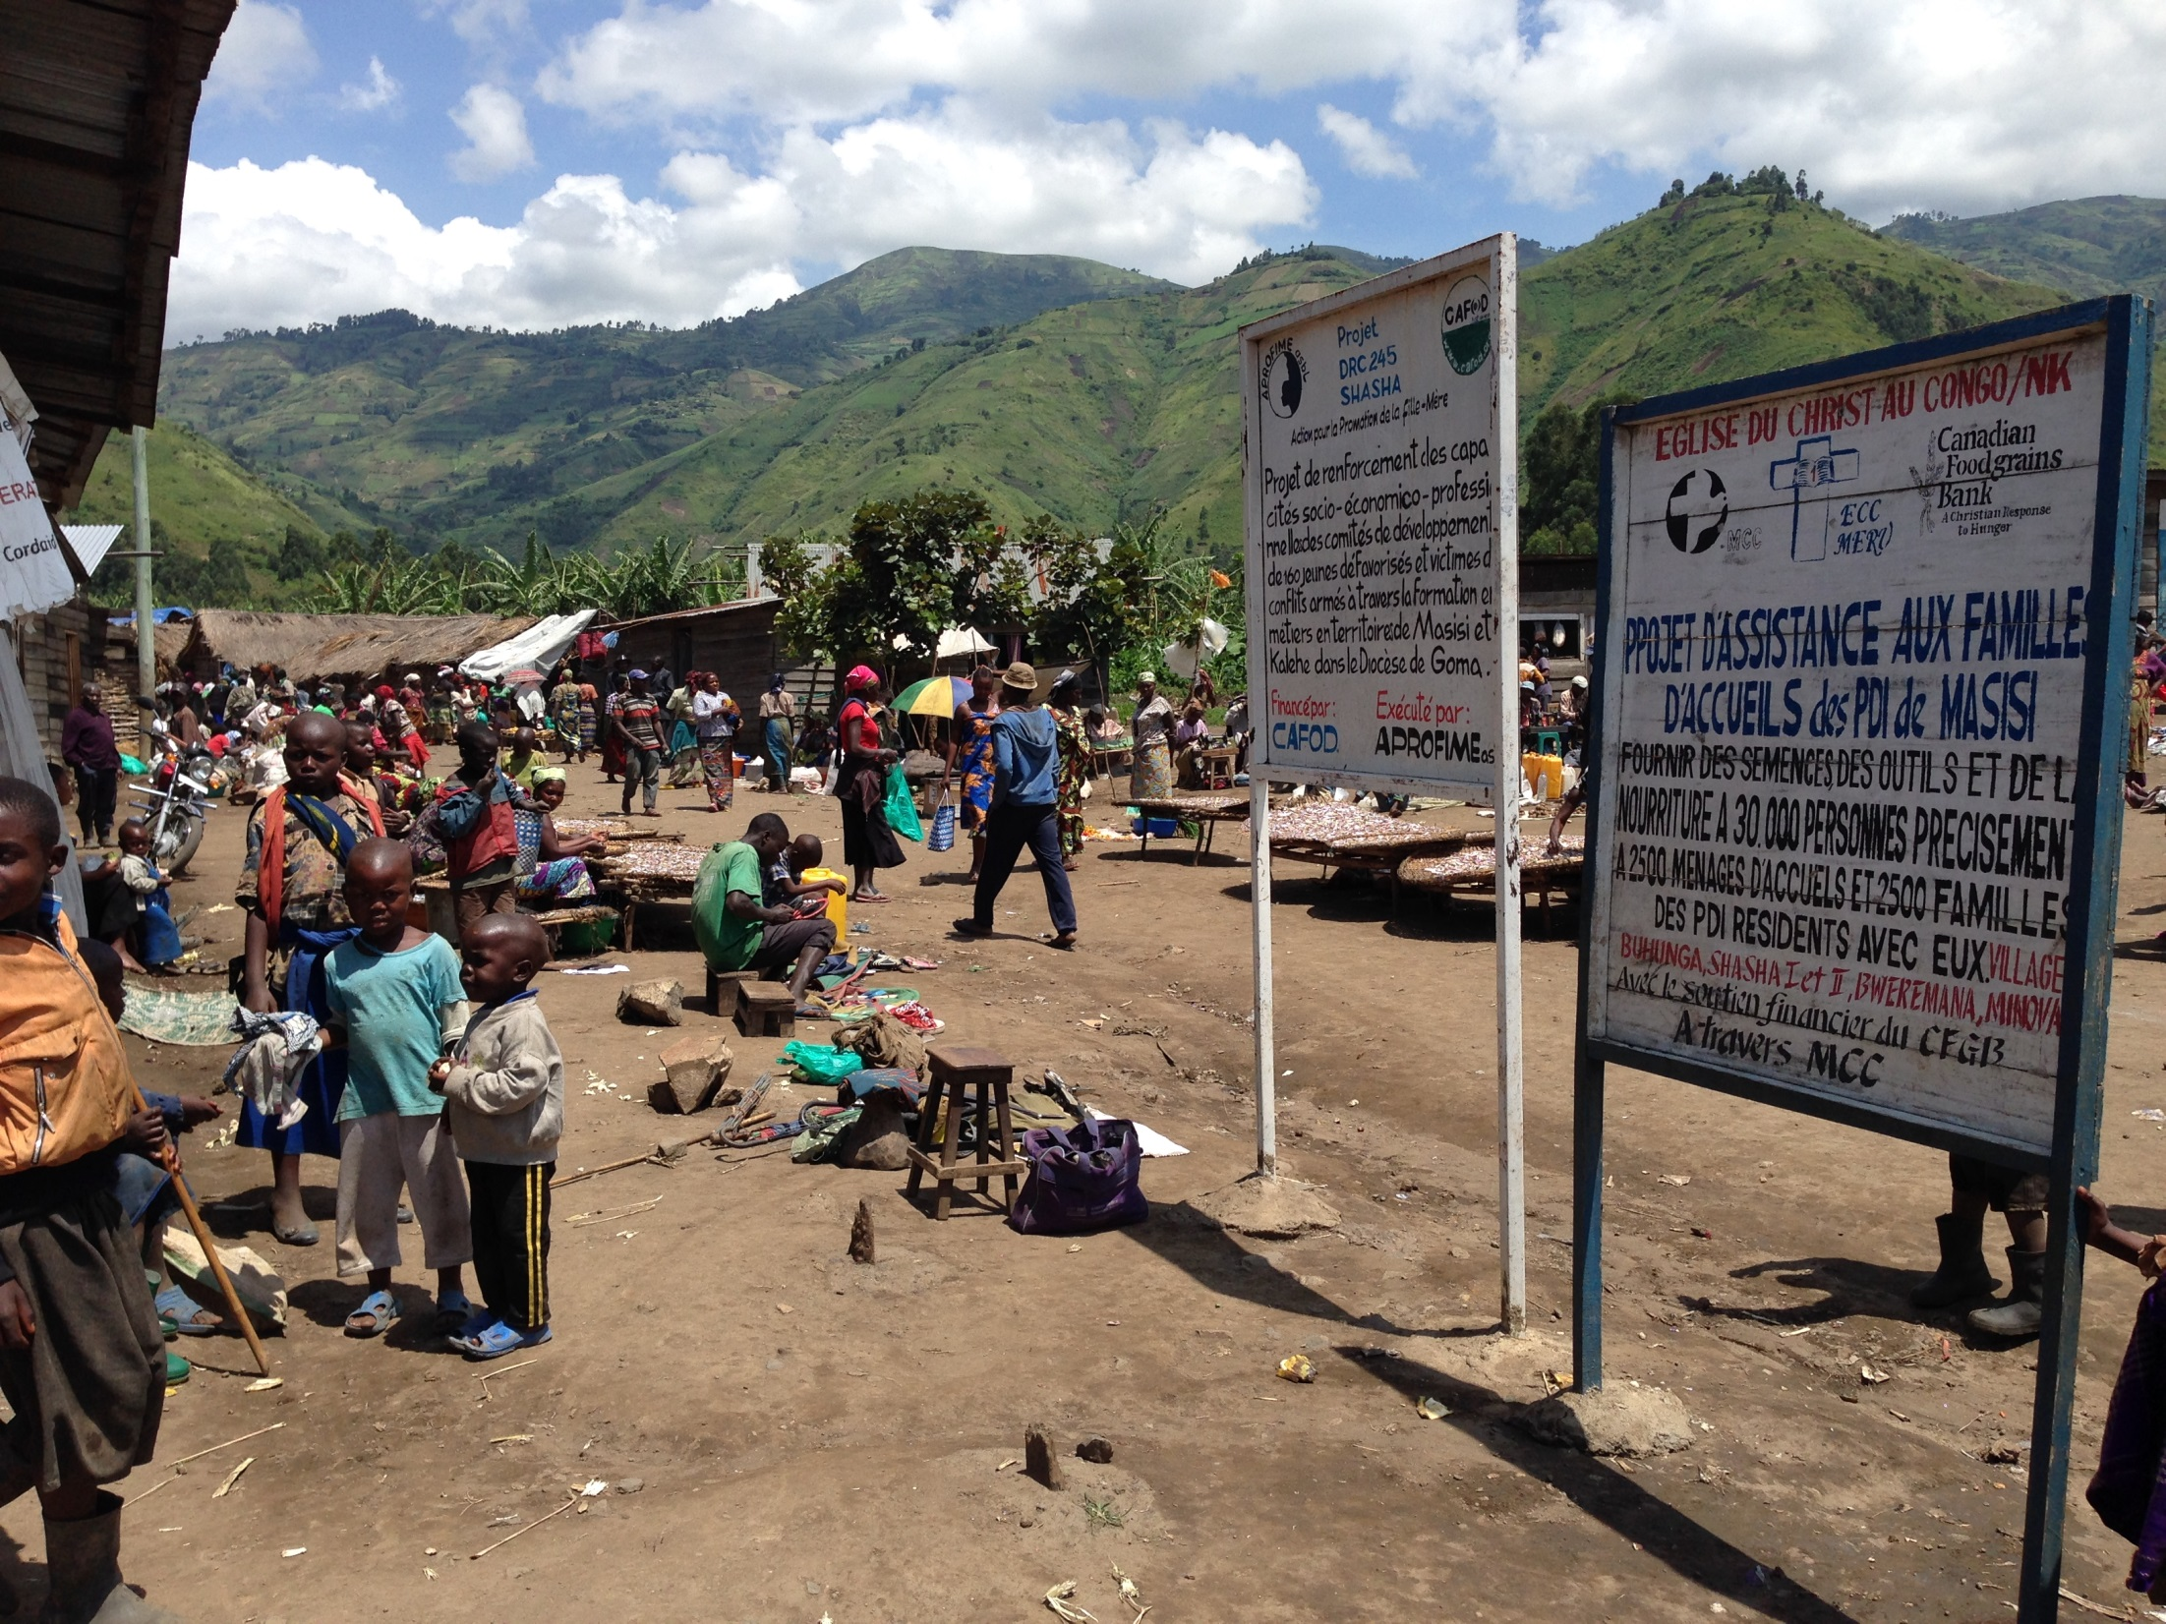

Slide 33
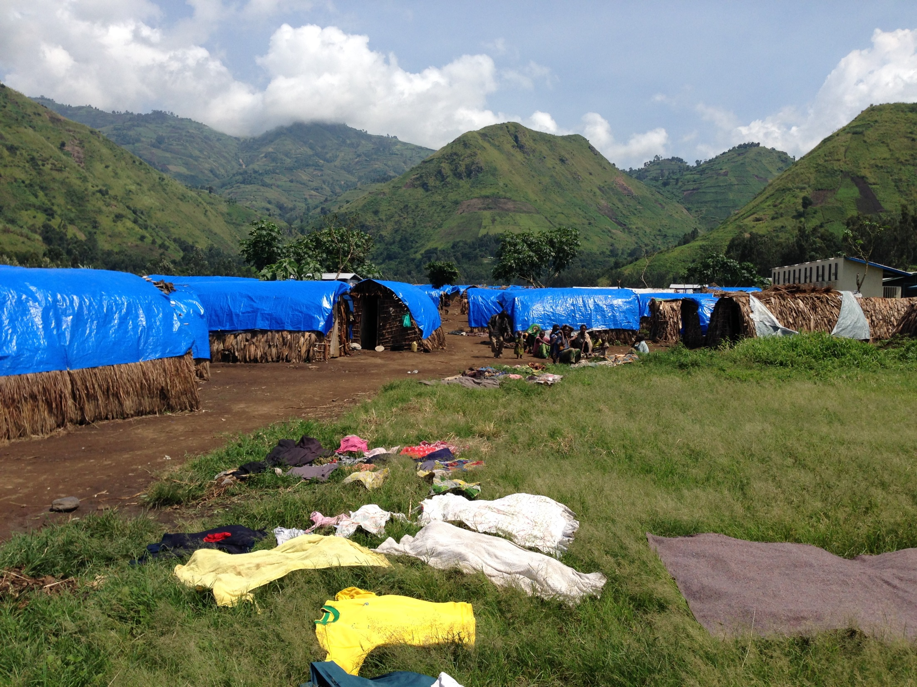

Slide 34
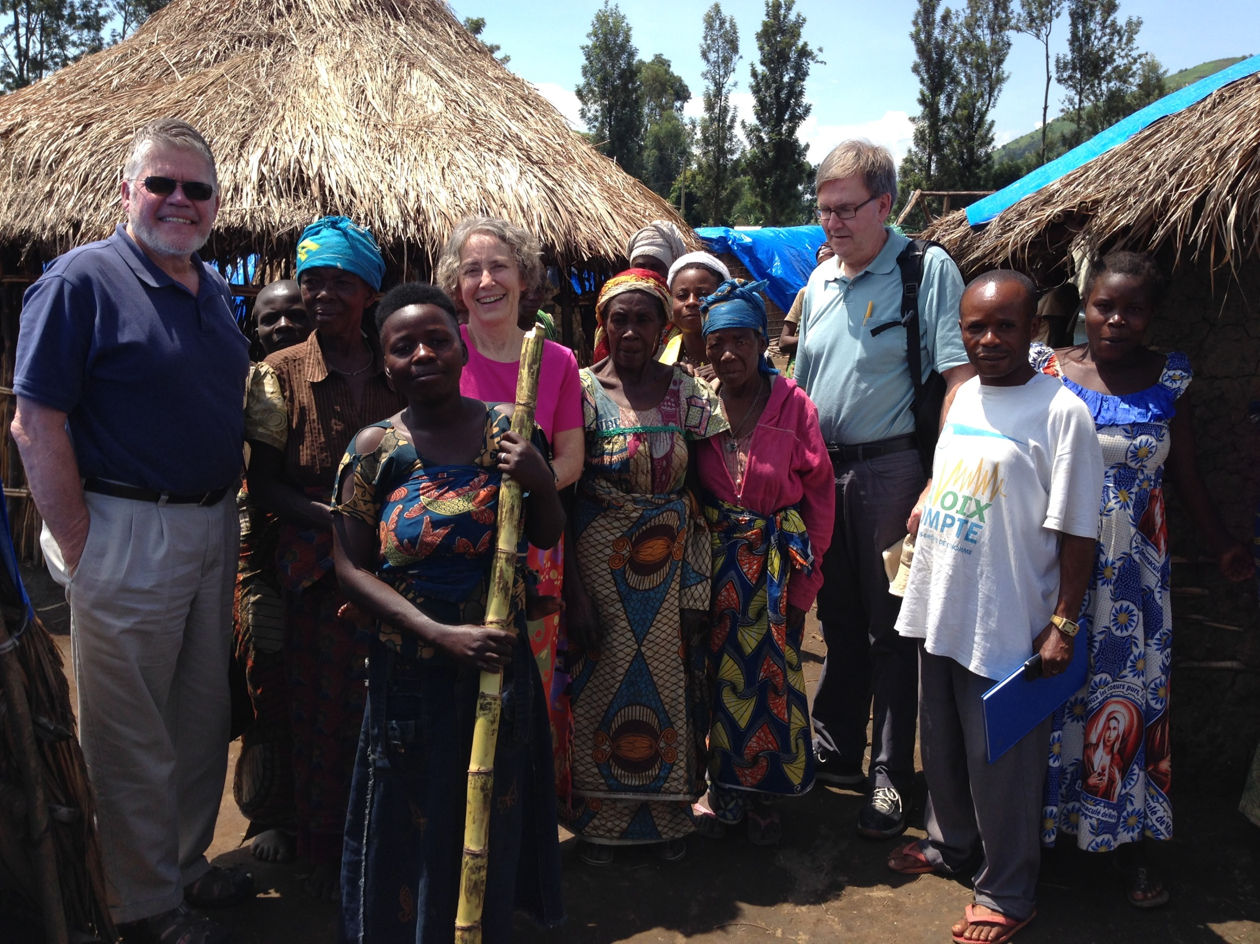

Slide 35
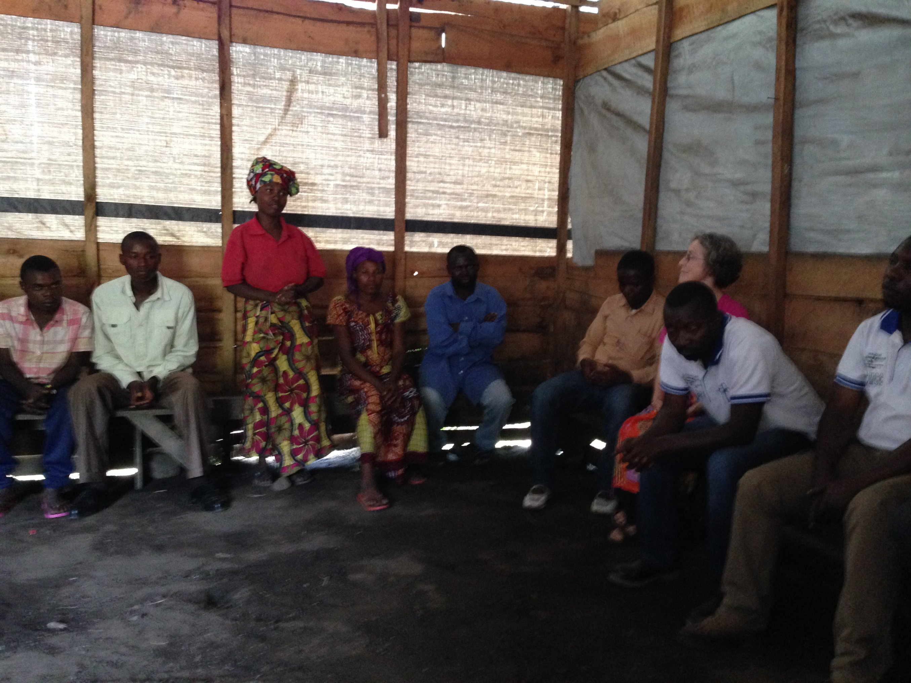

Slide 36
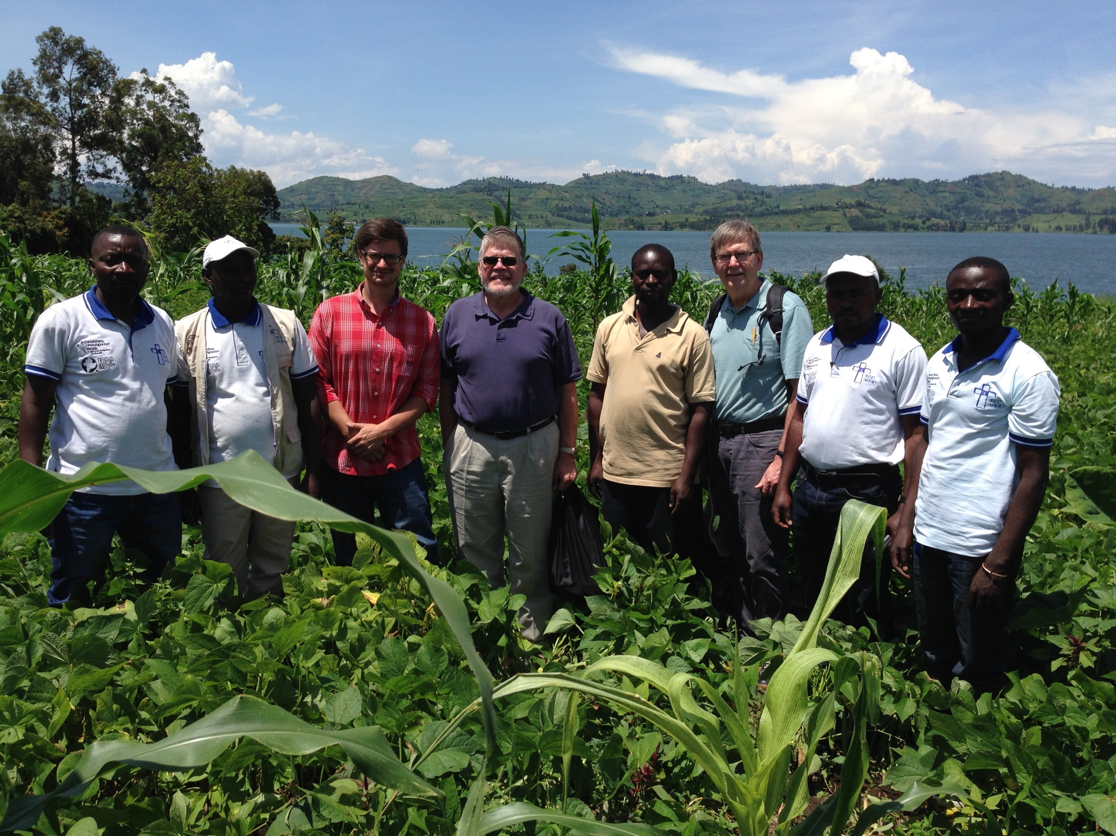

Slide 37
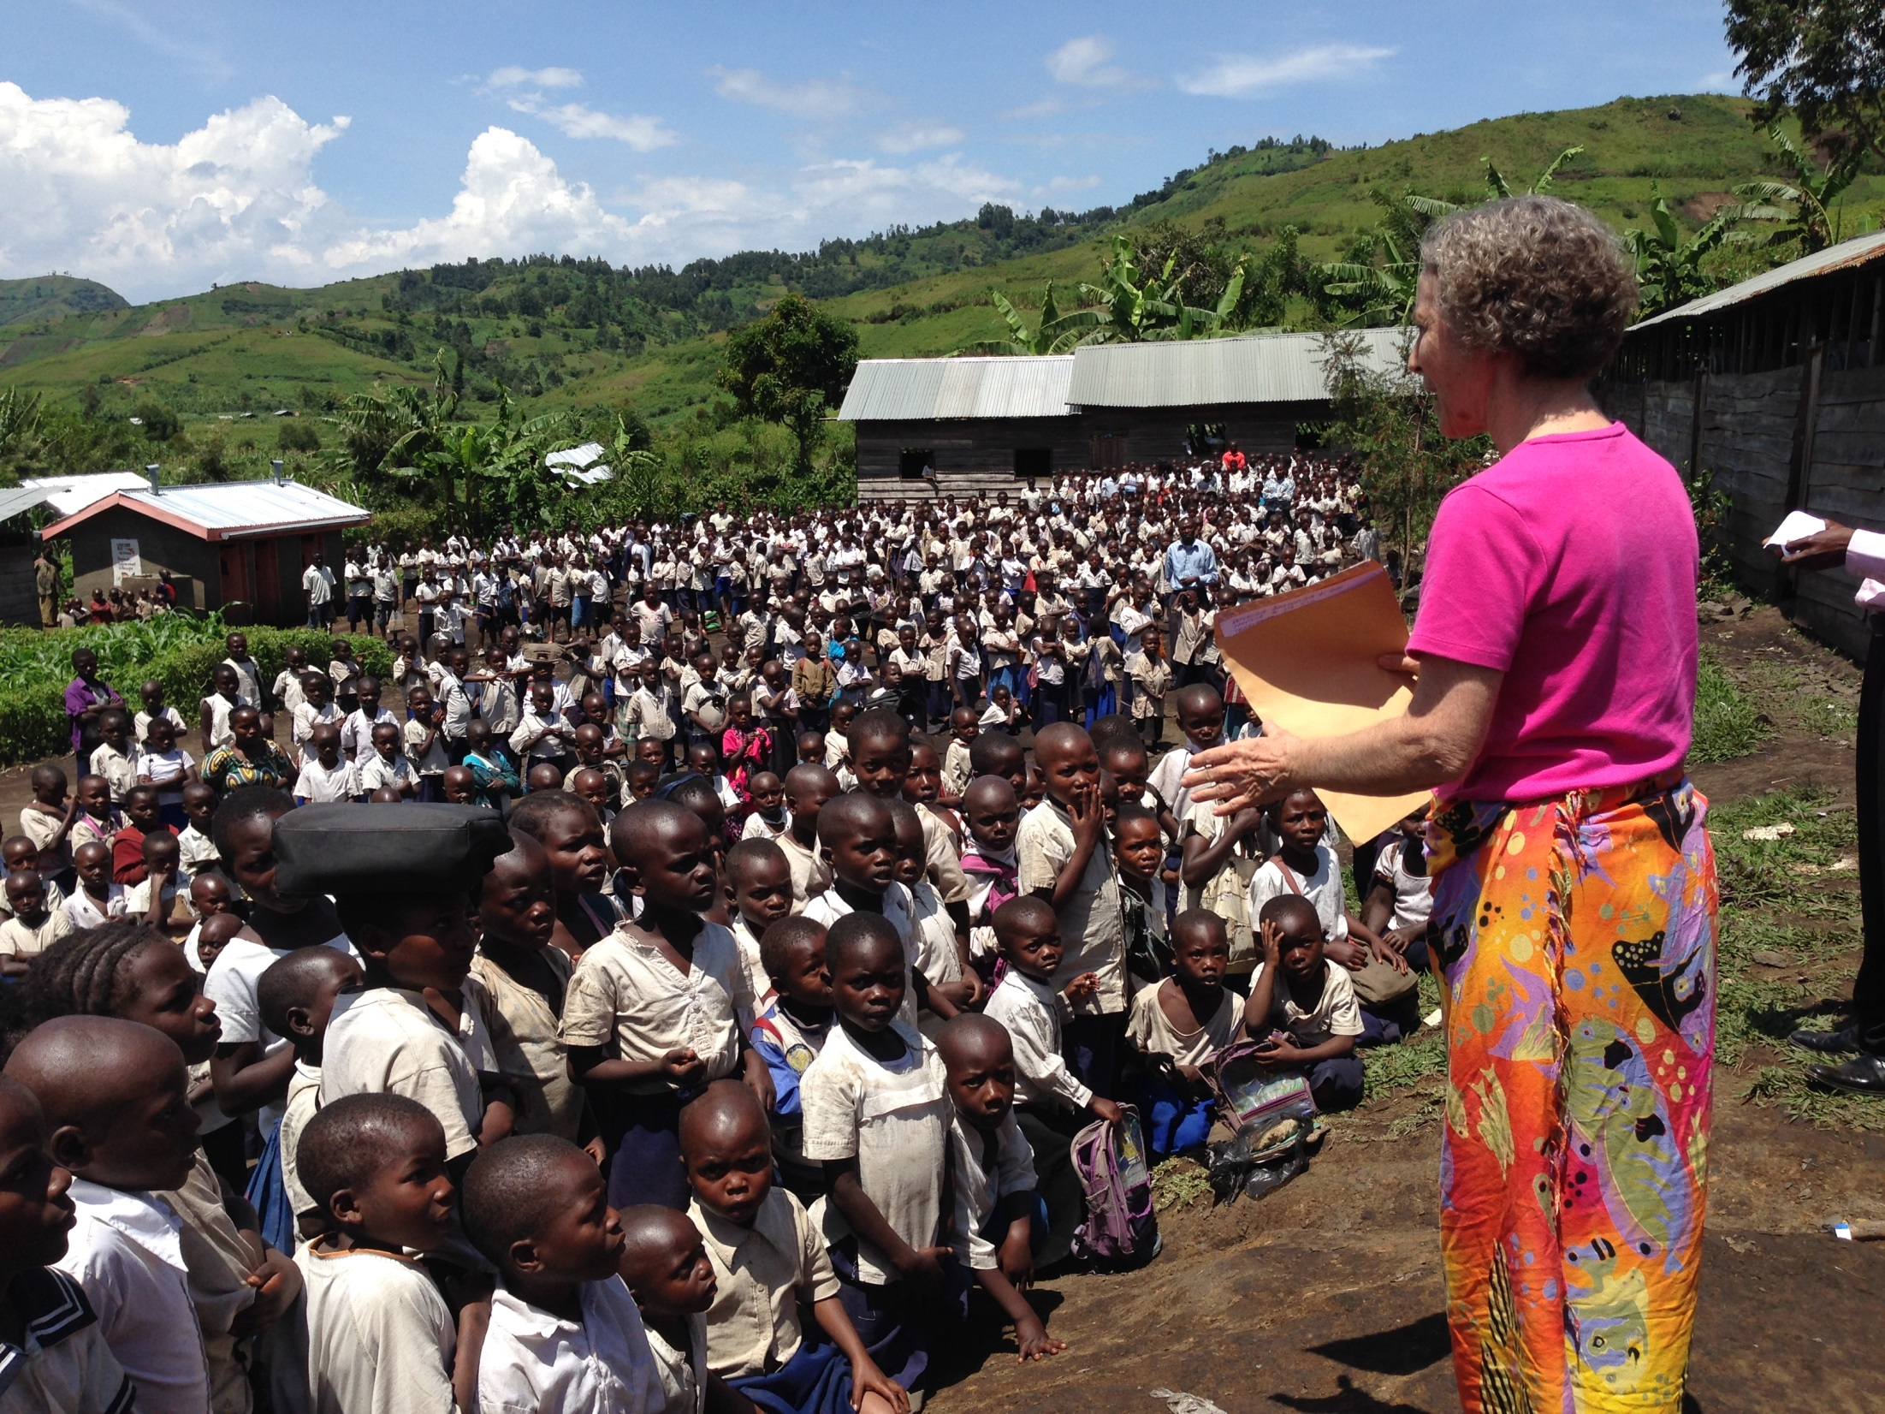

Slide 38
The Parable of the Good Samaritan (Luke 10:29-37)
29 But wanting to justify himself, he asked Jesus, ‘And who is my neighbor?’ . . .
³⁶Which of these three, do you think, was a neighbor to the man who fell into the hands of the robbers?’ ³⁷He said, ‘The one who showed him mercy.’ Jesus said to him, ‘Go and do likewise.’

Slide 39
Mennonite Central Committee Relief, development and peace in the name of Christ

