Slide 1
Writing Possible Selves:
A Collaborative Writing Partnership between Linguistically Diverse Middle School Students and
Pre-service Teachers
Beth Lehman, EMU & Margot Zahner, HCPS

Slide 2
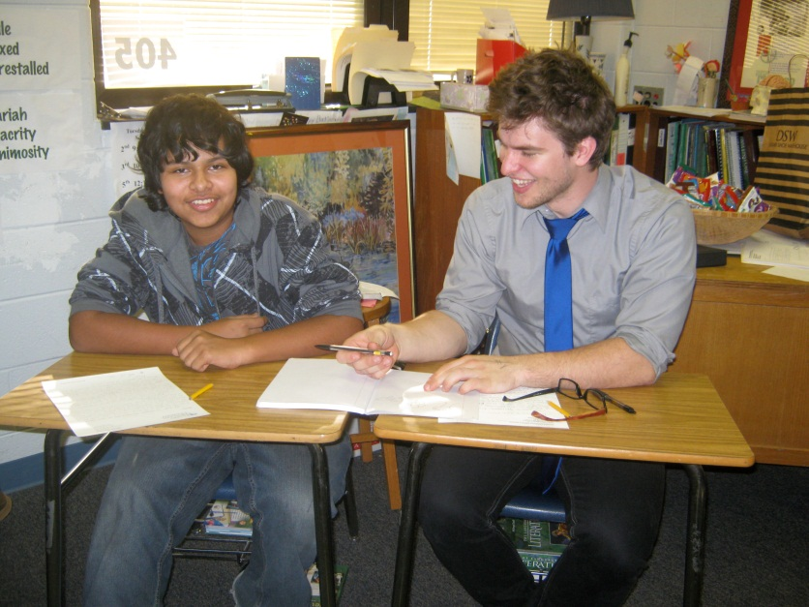
Session Goals
Tell stories about our the writing partnership between pre-service teachers and linguistically diverse students
Explore implications of the partnership experience.
Provide resources for creating college-middle school partnerships

Slide 3
Getting Started
Our Objectives
Develop mentorship relationships between 8th grade Reading Support Students and College Teacher Education students.
These relationships will include reading common texts, tours of mutual texts and letter exchanges in a shared composition notebook.
Through these relationships the college students will gain insights into the middle school student experience. The middle school students will gain a window into the college academic experience and develop a mentorship relationship with a caring adult

Slide 4
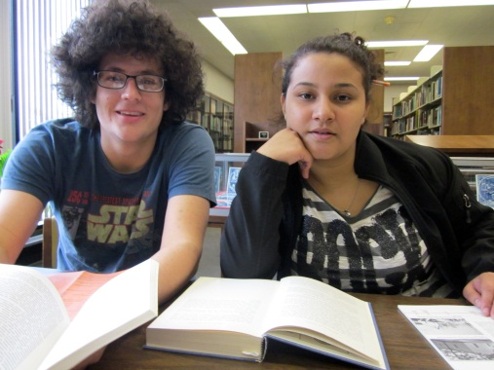
Our Students
Middle School Students
Middle School Curriculum & Methods
13 Reading Support students +1 and then 2
Selected for additional instruction in reading.
All American Minority or Immigrant students
Home languages include Spanish, Kurdish and English
Boys and girls
Our school population is 66% FRL and 40% ELL
14 teacher education students in middle school methods class.
8 female, 6 male
Small Mennonite college
13 white, 1 latina
History, math, PE, Spanish, English, Biology, Art majors

Slide 5
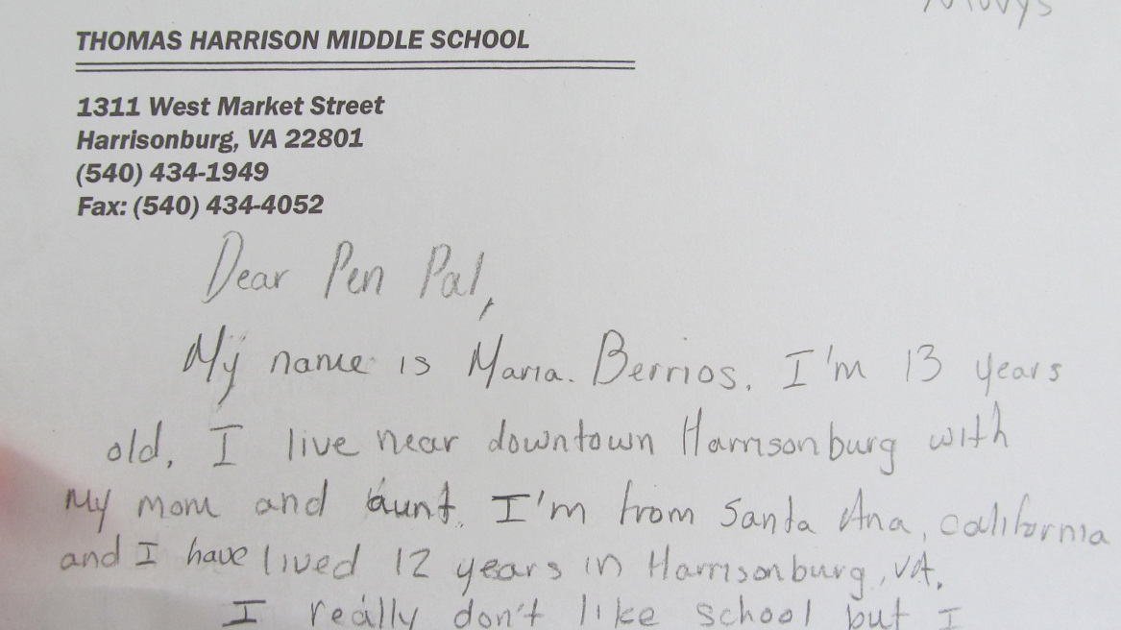
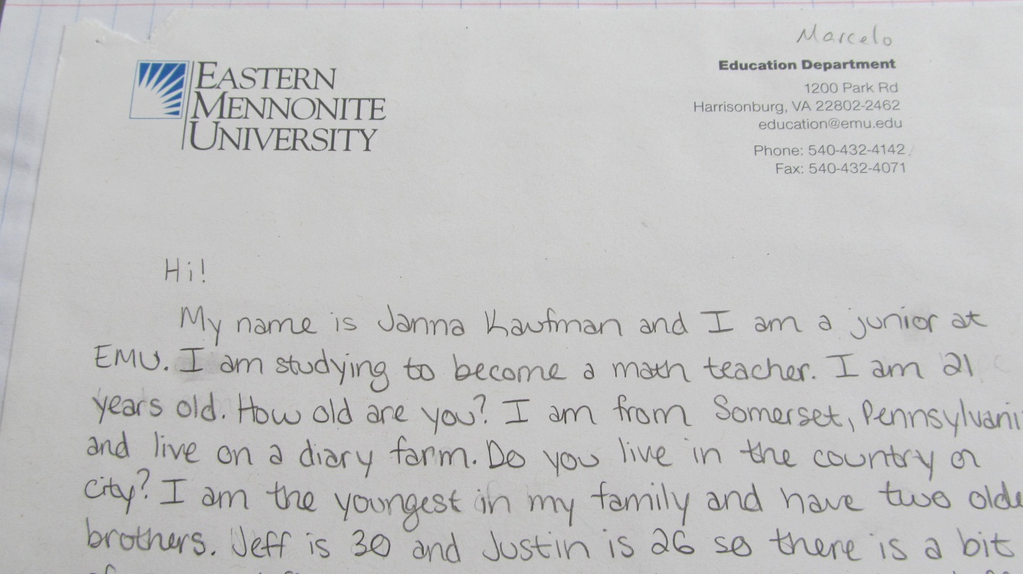
First Letters & Matching
Prompting Questions
Where are you from, what do you like to do?
What are some of your favorite books, movies, songs?
What are your favorite classes?
Where do you most want to visit in the world?
If you were an animal, what animal would you be and why?
What is your dream for yourself in 20 years?

Slide 6
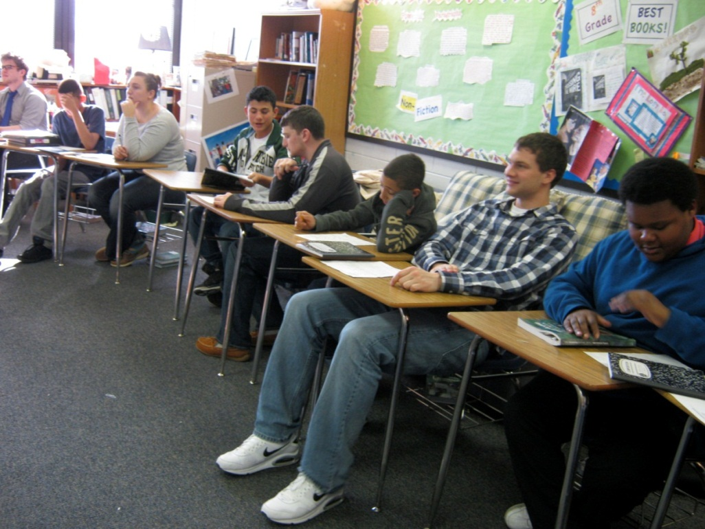
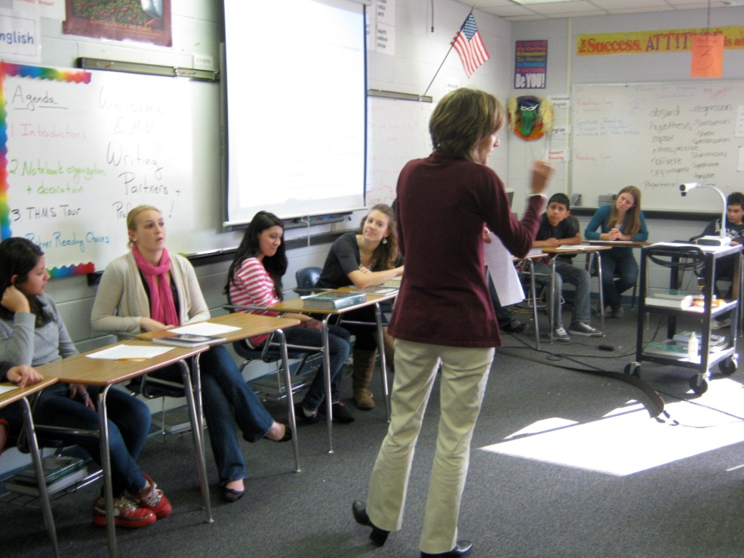
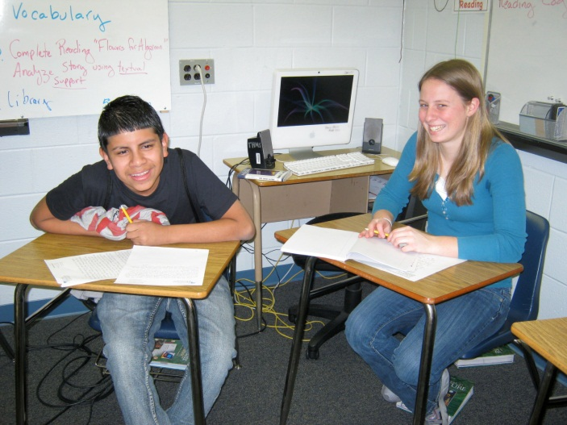
First Meeting
Introduction circle, notebooks & games
Middle School Student-led Tour
Choose books & snacks!

Slide 7
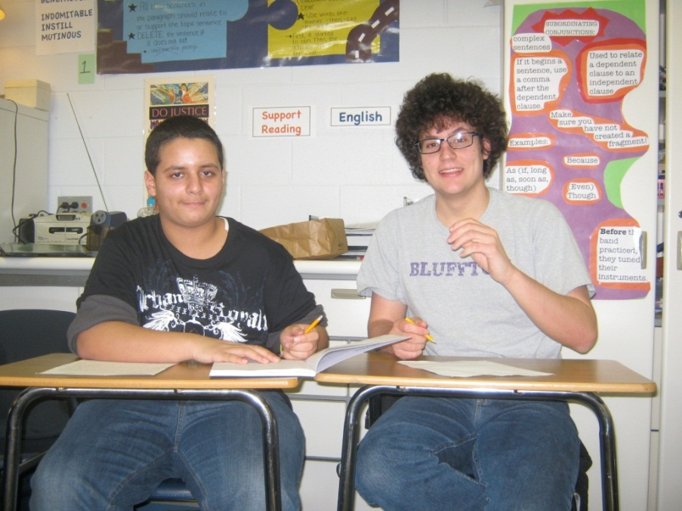
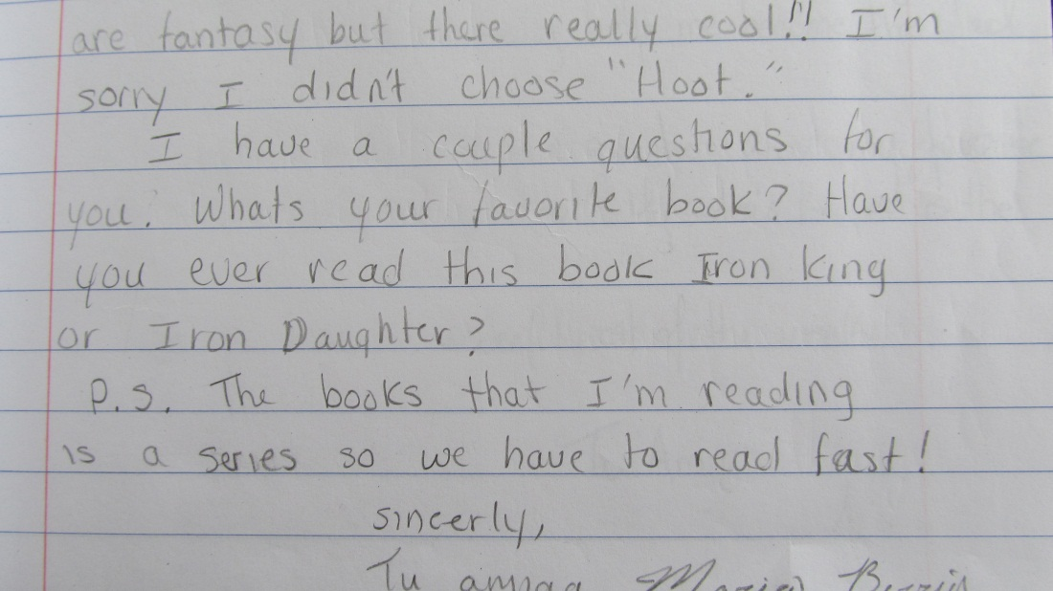
Full Steam Ahead~ Logistics
Bi-monthly letter exchange
Common reading of fiction & nonfiction
Margot visited EMU class
Practicum placements for pre-service teachers

Slide 8
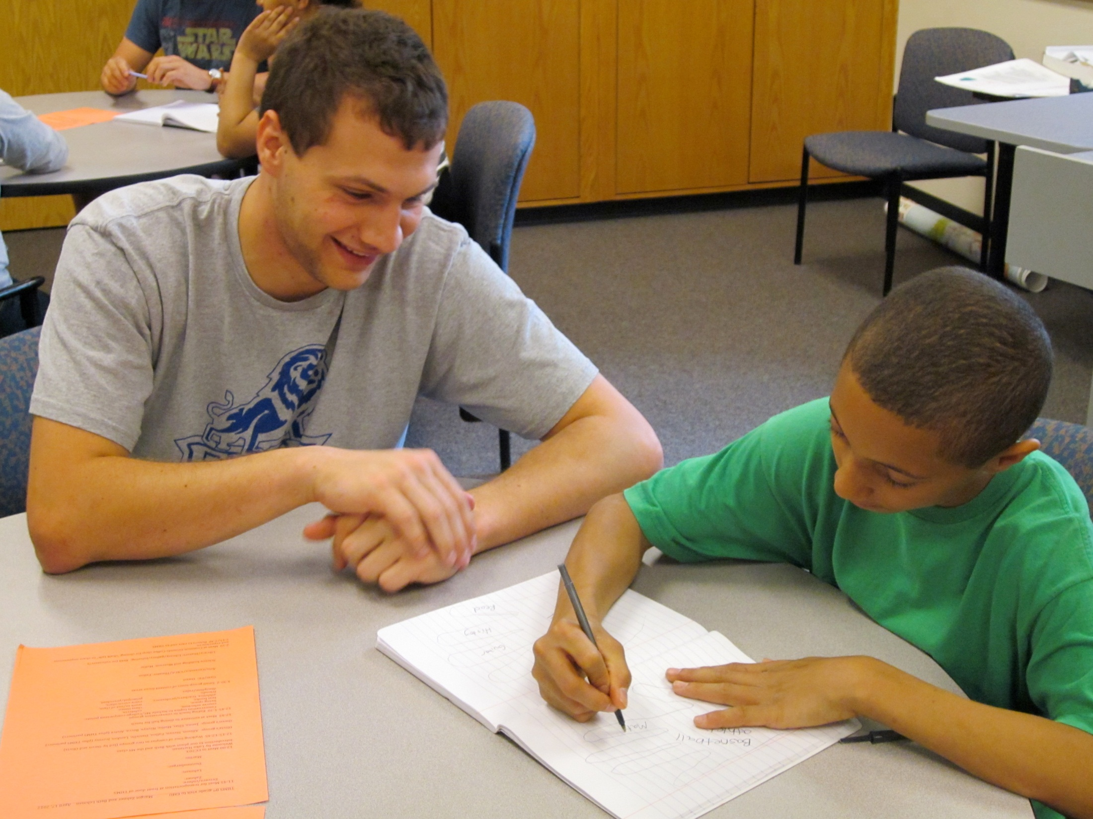

Slide 9
College Visit and Final Letters
Visit to Eastern Mennonite University
1. Welcome by the Director of Admissions
2. Walking tour of campus
3. Lunch with conversation topics &
unlimited ice cream
4. Content electives
5. Report back with posters and final circle

Slide 10
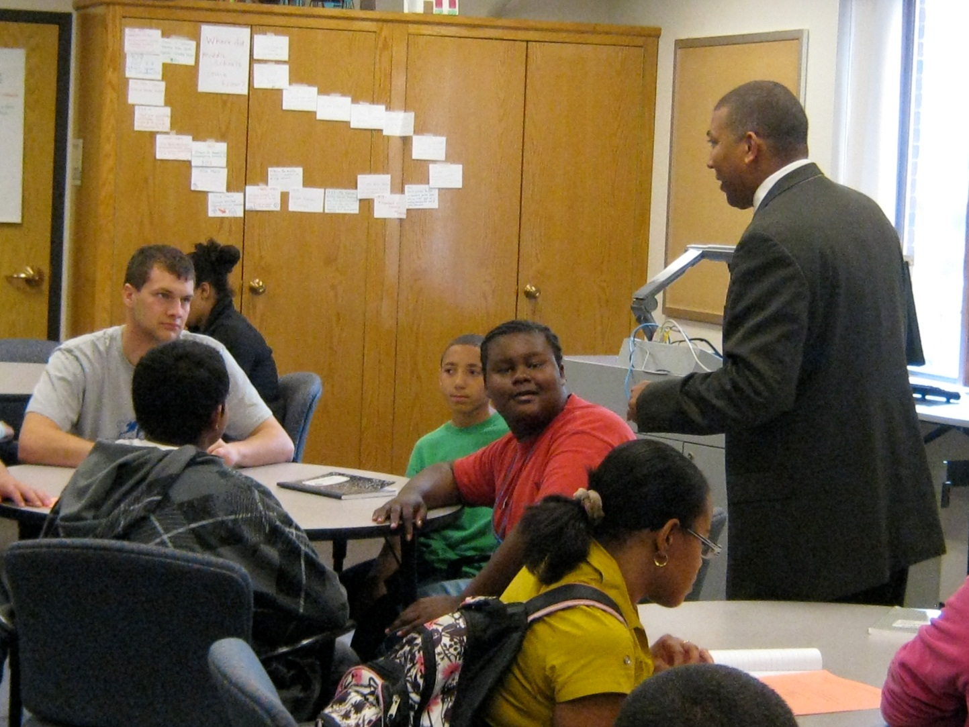
Luke Hartman, Director of Admissions Welcomes THMS students

Slide 11
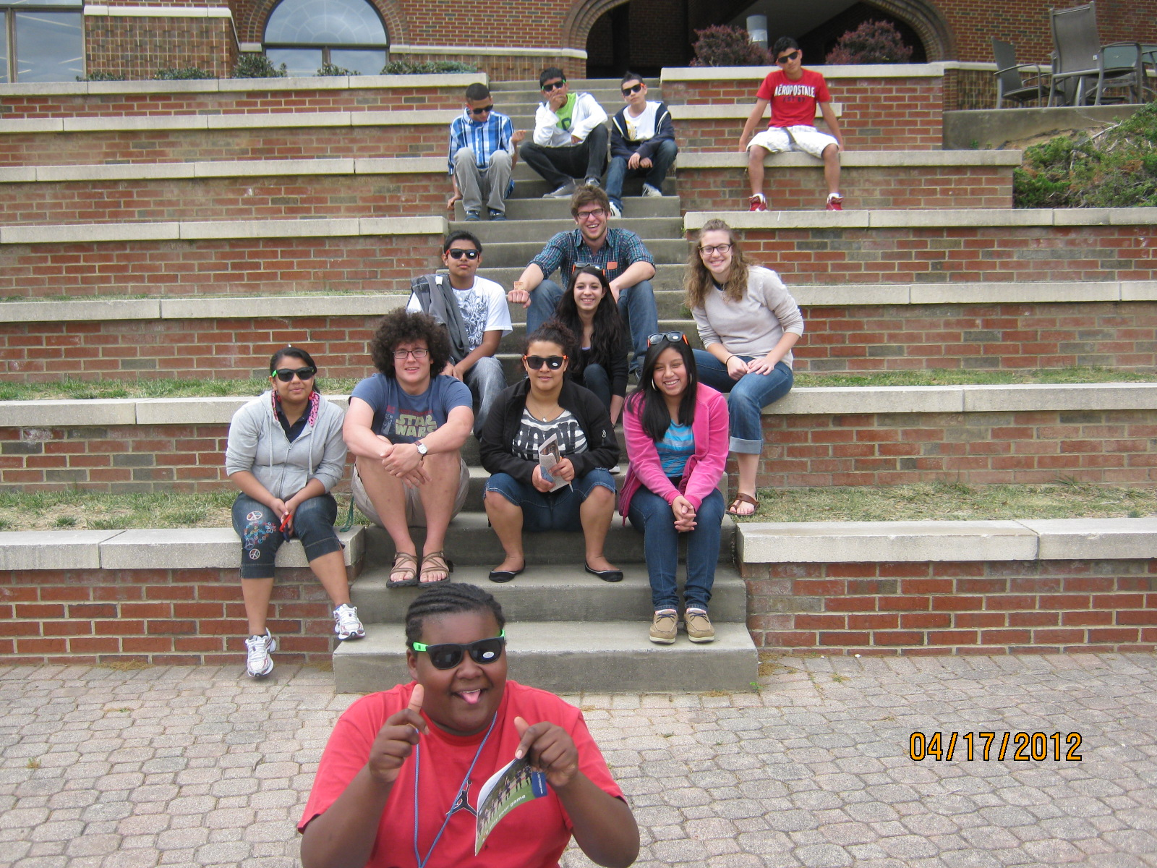

Slide 12
Reflections & Themes
Individual and Personal Connections
Exploring Possible Selves
Professional and personal balance for teacher education students
What are the implications for reading and writing?

Slide 13
Thoughts when planning a partnership
1. Consider most appropriate partnership
2. Establish shared purpose & goals—like your
teacher partner
3. Plan letter swapping dates in advance
4. Consider online, but don’t assume it will be better
5. Offer guidelines but don’t dictate content of letters
6. Vary purposes of letters
7. Explore shared readings
8. Include face-to-face meeting
9. Allow as much time as possible
10. Be flexible to needs as they surface

