Slide 1
Middle School Learning Community: An Oxymoron
Sandy Brownscombe, Ed.D.
Eastern Mennonite University
Mennonite Education Conference
February 3, 2012

Slide 2
Overview of Session
Introductions
Creating Communities of Learning
Ethic of Care
Restorative Discipline
Developmental Characteristics of Young Adolescents
Team and Small Group processing time

Slide 3
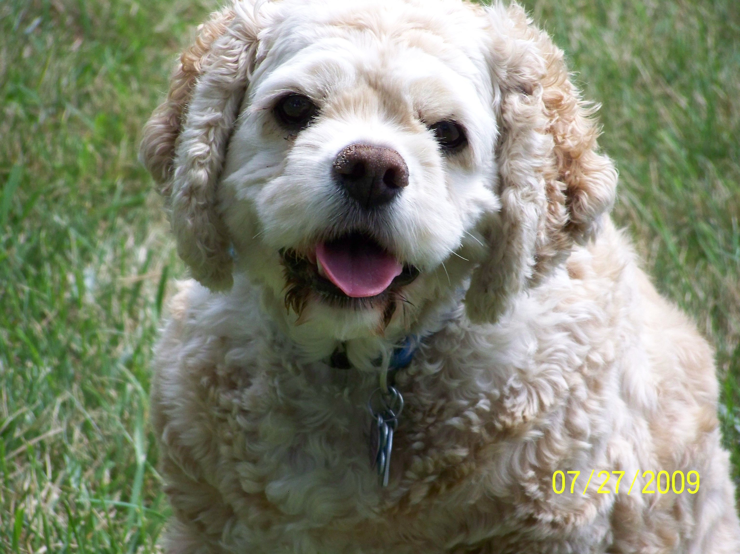

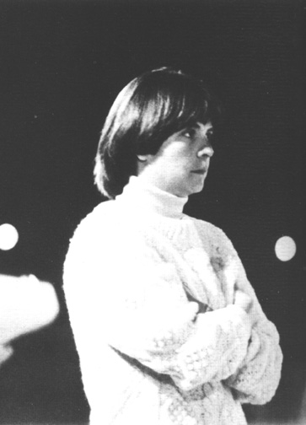






Introductions
Who are We?
University of Northern
Colorado
sandy.brownscombe@emu.edu
Where are you from?
What grade & content do you teach?
What do you hope to learn in this session?

Slide 4
Teaching That Transforms
Identify some key ideas that you have heard already about Teaching That Transforms that you think relate to creating caring communities of learning in a middle school classroom.

Slide 5
Teaching That Transforms
At its heart, Anabaptist-Mennonite pedagogy is about relationships. (Roth, p.94)
Characteristics of good teachers are dispositions…dispositions are cultivated habits. (Roth, p. 109)

Slide 6
Teaching That Transforms
As teachers model these dispositions in their daily encounters with students, they not only create a context for learning the subject matter at hand, they also invite students to nurture similar dispositions, which will enhance their learning for the rest of their lives. (Roth, p. 111)

Slide 7
Teaching That Transforms
Curiosity: Humility Seeking Understanding
  Asking good questions may be as important as the answers
Reason: Celebrate the Gift of the Mind
  Seek out patterns of interconnection that hide below the surface
  Model careful thinking
  No question should be off-limits

Slide 8
Teaching That Transforms
Joy: Education Is Not Drudgery
  Be open to the “aha” thrill of discovery
Patience: “If You Knew It All You Would Not Need to Be Here”
Love: Created in the Image of God
(Roth, p. 111-119)

Slide 9
Ethic of care
All people everywhere want to be cared for
Manifestations of caring relations differ across times, cultures, and individuals’
Universal desire to be cared for
(Noddings 2002)

Slide 10
Caring Teacher
"A caring teacher directs his or her energy to care for students in the form of taking action(s) --the actions required to meet the unfilled needs of the students" (Lisle, 2001, p. 140).
"One who regularly establishes caring relations--not merely as one who possess certain virtues" (Noddings, 2001b, p. 103).

Slide 11
Caring Actions
Caring learning environments allow students to feel safe, make mistakes, and work collaboratively with others while the teachers in these classrooms make connections to students prior learning, interests, and are culturally responsive to their students
(Gay, 2000; Goldstein, 2002; Lin, 2001; Noddings, 1992, 2001c, 2002)

Slide 12
Caring Actions
Schools that exhibit the characteristics of caring learning communities are necessary if students are to reach their academic potential.
(Noddings, 1992; Larrivee, 2000)

Slide 13
Actions of Caring Teachers
Actively listens to students
Makes eye contact with students
Helps students with homework
Varies instruction to meet the needs of individual students
Provides clear explanations of assignments
Checks for understanding

Slide 14
Actions of Caring Teachers
Provides students with necessary materials
Displays students' work
Adjusts the schedule
Maintains a safe learning environment
Applies consistent classroom management
Spends time outside of class with students
Collaborates with colleagues (Brownscombe, 2004)

Slide 15
Words of Caring Teachers
Calls students by name
Uses a positive communication style
Expresses high expectations for all students
Asks students' their opinion
Recognizes students for individual achievement in and out of class
Communicates with parents (Brownscombe, 2004)

Slide 16
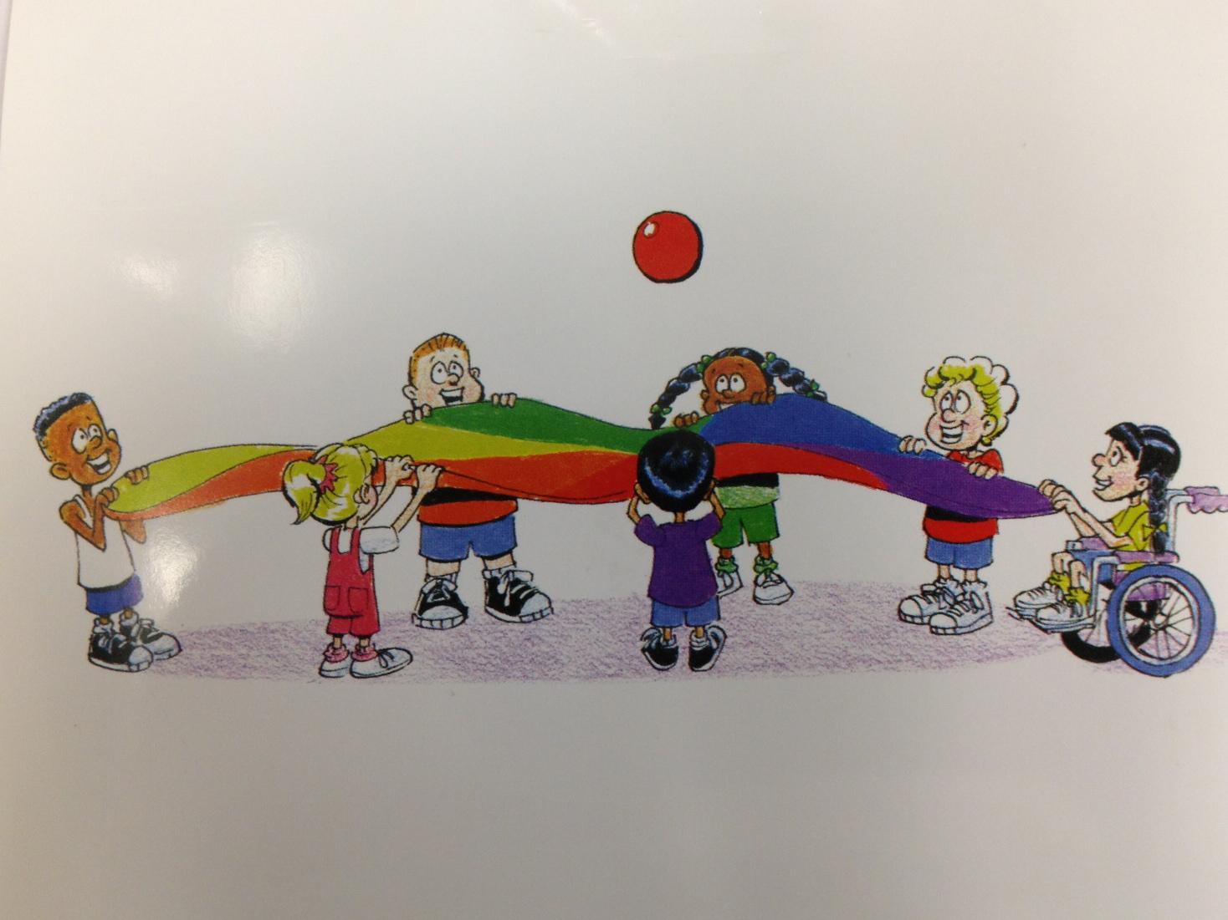
Identify various ways that you demonstrate an Ethic of Care in your classroom
Think-Pair-Share

Slide 17
Restorative Discipline
Acknowledges that relationships are central to building community.
  Strengthen relationships
  Build community
  Encourage a caring school climate
  Students involved in the process
  All members feel valued

Slide 18
Restorative Discipline
Builds systems that address misbehavior and harm in a way that strengthens relationships.
  Provide a safe place to learn
  Agreement among policies and values
  Address the root cause not the symptom
  Organize in small units

Slide 19
Restorative Discipline
Focuses on the harm done rather than only on rule-breaking.
  Misbehavior is an offense
  Solution involves everyone
  Person harmed is the center
  Correction of perceived injustice

Slide 20
Restorative Discipline
Gives voice to the person harmed.
  Immediate safety concerns
  Opportunity of those harmed to have a voice

Slide 21
Restorative Discipline
Engages in collaborative problem-solving.
  Danger & opportunities of misbehavior
  Satisfying human needs
  Involve extended community to meet student needs
  Teachable moment

Slide 22
Restorative Discipline
Empowers change and growth.
  Need help identifying needs
  Need assistance in meeting needs
  Interpersonal conflict is normal
  Conflict presents opportunity for change

Slide 23
Restorative Discipline
Enhances Responsibility.
  Need to understand the impact of actions
  Evaluate consequences
  Invite responsibility and cooperation
  “walk behind” rather “walk alongside” (Amstutz, L. S. & Mullet, J. H. 2005)

Slide 24
And Change Begins!!!
Occurs between the ages 10 and 15
Rapid and profound personal changes
Conscious witnesses of their own growth
Infants are not witnesses of their own development. (This We Believe, 2010, 5)

Slide 25
Physical Development
Middle school students ask the question “Am I normal?”
The first sign that puberty is beginning
Growth spurt begins at approximately 10 for girls and 12 for boys
(Brown & Knowles, 2007, 13-14)

Slide 26
Growth Spurt
Average height gain
  Females: 7 inches
  Males: 9 to 10 inches
Average Weight gain
  8 to 10 pounds per year
  40 to 50 pounds overall
(Brown & Knowles, 2007, 13-14)

Slide 27
Skeletal and Muscular Changes
The Awkward Stage
  rapid and uneven changes
  big feet
  long arms and legs
Sitting in hard improperly fitted school chairs can be very uncomfortable and lead to fidgeting.

Slide 28
Skeletal Changes
The three tail bones fuse and harden into their final adult form
The process can cause pain and discomfort (Brown & Knowles, 2007, 15)
Adolescents experience increased sensitivity around their growth plates especially in their legs.

Slide 29
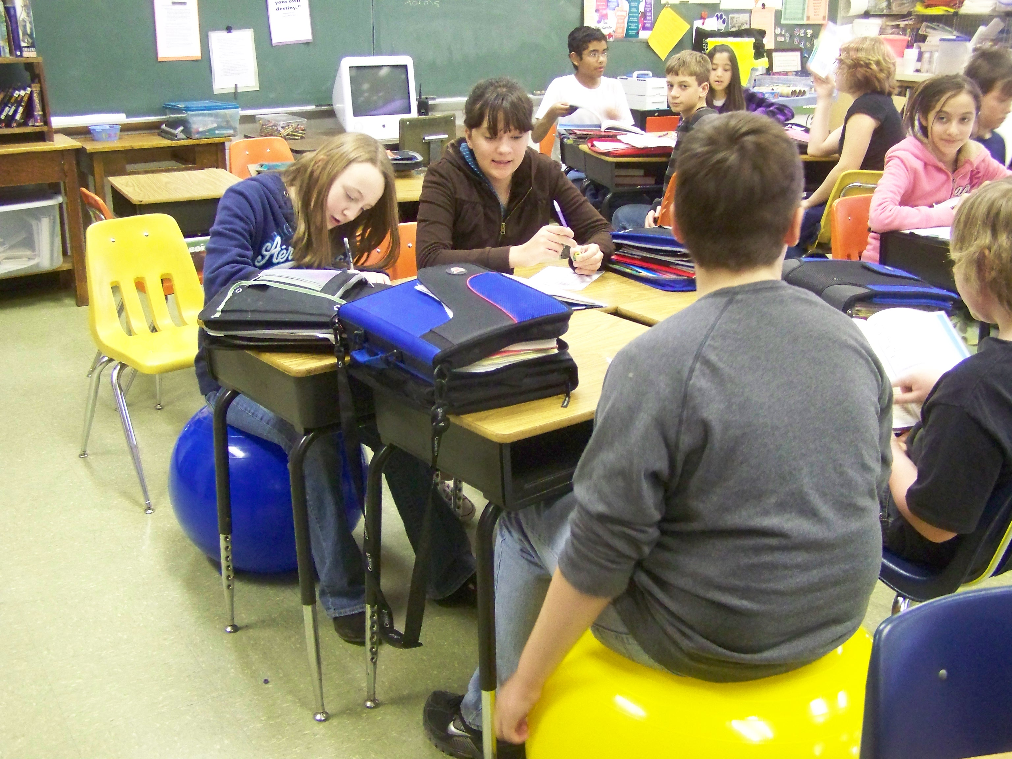
Alternatives to Hard Chairs

Slide 30
Sousa (1998) has shown that after people have been sitting for 20 minutes the blood leaves the brain and starts to pool in the seat and feet. After standing for just 15 seconds, the amount of blood flow to the brain has increased by 15 percent. Allowing students to stand and move every 15 to 20 minutes significantly increases blood flow to the brain and alertness. (Vatterott, 2007, 81)

Slide 31
Adolescents’ Food Needs
Middle school students may need to eat again before lunch even if they had a good breakfast, given their metabolic changes.
Snack breaks result in higher levels of concentration and fewer discipline problems. (Vatterott, 2007, 81)

Slide 32
Piaget’s Four Stages Of Intellectual Development
  Sensorimotor (birth to 2 years)
  Preoperational (2 to 7years)
  Concrete operational (7 to 11 years)
  Formal operational (12 years to adulthood)

Slide 33
Concrete Operational Thought
Most middle school students remain in the concrete operational stage through
eighth grade.
(Brown & Knowles, 2007, 30)

Slide 34
Moving from Concrete to Formal Operational Thought
“Only about one third of eighth graders consistently demonstrate an ability to use formal operations” (Brown & Knowles, 2007, 32)
Students move between Concrete and Formal Operational Thought depending on the content

Slide 35
Concrete Operational Thought
Children in the concrete stage can only reason about those things for which they have had direct, personal experience (Brown & Knowles, 2007, 29)

Slide 36
Concrete Operational Thought
Manipulatives, role-playing, and hands-on activities are critical during all of middle school and the concrete operational stage. (Brown & Knowles, 2007, 30)

Slide 37
It is important that lessons are planned so that students have an opportunity to interact intellectually with new concepts, principles, ideas, and theories if your teaching will help move them from concrete to formal operational thought. (Brown & Knowles, 2007, 33)

Slide 38
Cognitive processing won’t improve or develop as well if students are consistently taking notes or memorizing dates without opportunities to make genuine connections between content and their experiences.
(Brown & Knowles, 2007, 27)

Slide 39
Developing Learning Activities Responsive to Characteristics of Young Adolescents
Begin lessons with the concrete
Create lessons that are brief but fairly intense
Allow students to interact with one another and with materials
Be prepared for off-the-track responses

Slide 40
Ask exploratory questions that require higher-level thinking
  What if?
  How do you know?
  Are you sure?
  Will you think out loud please? Or Let me hear you think out loud?
  Of what value is this information to you?

Slide 41
Leave some loose ends, and leave some questions unanswered.
Create an environment where taking risks and chances is safe.
Create authentic lesson presentations, demonstrations, and experiences.
Use visual aids.

Slide 42
Provide opportunities for students to explore materials for themselves—both individually and with others.
Utilize a wide variety of teaching techniques.
Ensure opportunities to rehearse and practice key concepts. (Schurr, Thomason, Thompson, & Lounsbury, 1995, 5-8).

Slide 43
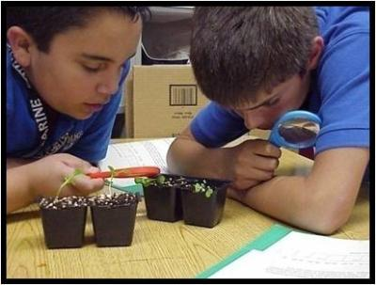


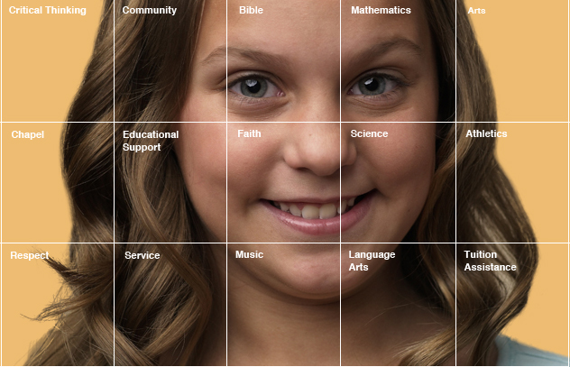
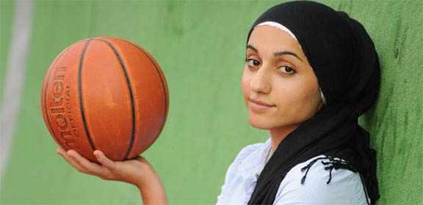
So how will you provide a community of learning?

Slide 44
Developmental Characteristics and Instructional Implications
Development
Characteristics
Physical
Cognitive-intellectual
Moral
Psychological
Social-Emotional
Specific Instructional Implications

Slide 45
Reference List
  Amstutz, L. S. & Mullet, J. H. (2005). The little book of restorative discipline for schools: Treating responsibility; creating caring climates. Intercourse, PA: Good Books.
  Bosworth, K. (1995). Caring for others and being cared for: Students talk caring in school. Kappan, 76, 686-693.
Brown, D. F., & Knowles, T. (2007). What every middle school teacher should know (2nd ed.). Portsmouth, NH: Heinemann.
Brownscombe, S. L. (2004). Infusing An Ethic Of Care In A P-12 Learning Community: A Case Study Of Second And Third-Year Teachers. Unpublished doctoral dissertation, Argosy University/Sarasota, Sarasota, Florida.

Slide 46
Reference List
Forte, I. & Schurr, S. (1993). The definitive middle school guide: A handbook for success. Nashville, TN: Incentive Publications, Inc.
Gay, G. (2000). Culturally responsive teaching: Theory, research, and practice. New York: Teachers College Press.
George, P. S. and Alexander, W. M. (2003). The exemplary middle school, (3rd ed.). Belmont, CA: Wadsworth/Thompson Learning.
Goldstein, L. S. (2002). Reclaiming caring in teacher education. New York: Peter Lang.
Larivee, B. (2000). Creating caring learning communities. Contemporary Education, 71(2), 18-22. Retrieved October 23, 2001 from www:http://ehostvgw8.epnet.com

Slide 47
Reference List
Lisle, C. K. (2001). The caring ethos in education: A qualitative study of the significance of caring teachers in creating possibilities for African American students. ProQuest Digital Dissertations: UMI No: 3032206.
Manning, M. L., & Bucher, K. T., (2009). Teaching in the middle school.(3rd ed.). Boston: Pearson.
McDonald, E. (2010). Fidgeting Students in the Classroom. Inspiring Teachers, Weekly Teaching Tips Newsletter, January 29, 2010
National Middle School Association. (2010). This we believe: Keys to educating young adolescents. Westerville, OH: NMSA
Noddings, N. (1992). The challenge to care in schools: An alternative approach to education. New York: Teachers College Press.

Slide 48
Reference List
Noddings, N. (2001a). Care and coercion in school reform. Journal of Educational Change, 2, 35-43.
Noddings, N. (2001b). The caring teacher. In V. Richardson (Ed.). Handbook of research on teaching (4th ed., pp. 99-105). Washington, DC: American Educational Research Association.
Noddings, N. (2002). Educating moral people: A caring alternative to character education. New York: Teachers College Press.
Schurr, S. L., Thomason, J., Thompson, M., & Lounsbury, J. H. (Eds.). (1995). Teaching at the middle level: A professional’s handbook. Lexington, MA: D.C. Heath and Company
Vatterott, C., (2007) Becoming a middle level teacher. Boston: McGraw Hill.

